Slide 1
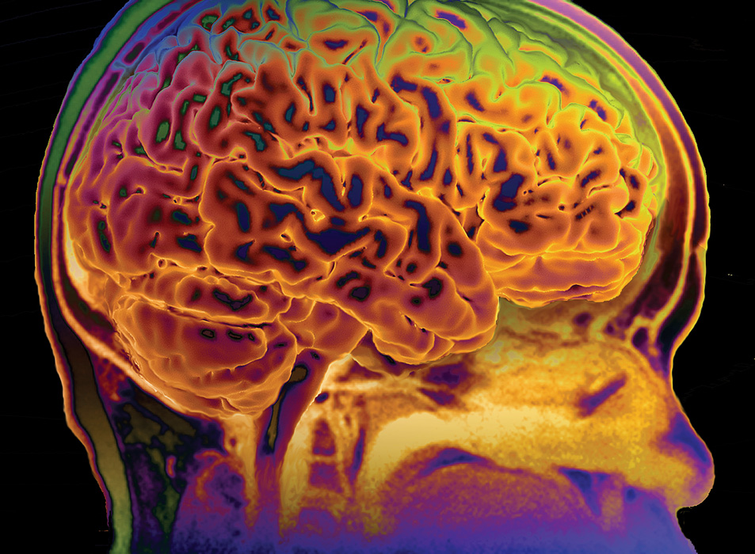
KEY CONCEPT The central nervous system interprets information, and the peripheral nervous system gathers and transmits information.

Slide 2
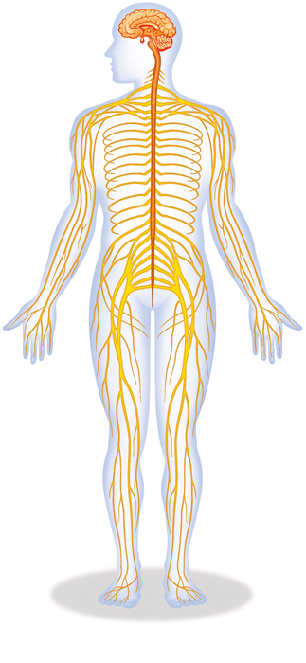
The nervous system’s two parts work together.
The CNS includes the brain, brain stem, and spinal cord.
The PNS includes four systems of nerves.

Slide 3
The CNS and PNS pass signals between one another.
Sensory receptor generates impulse.
PNS passes impulse to CNS.
CNS interprets impulse.
CNS passes impulse to PNS.
PNS stimulates a response.

Slide 4
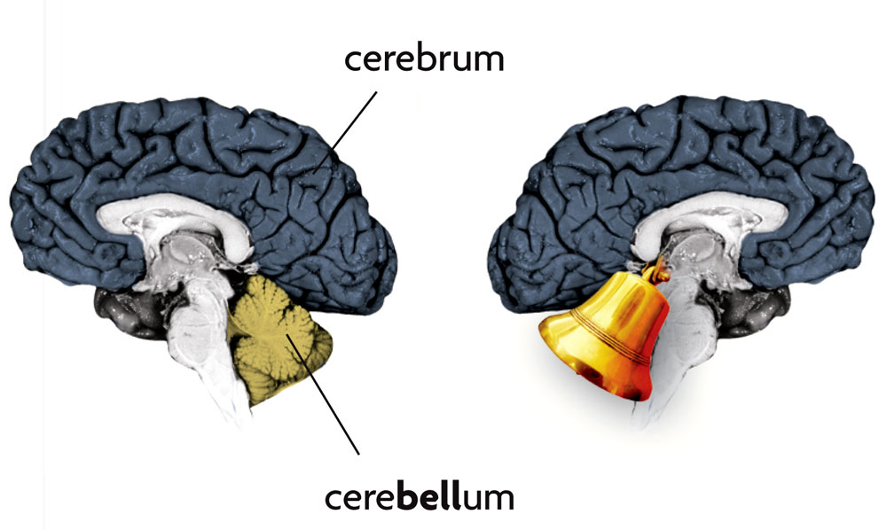
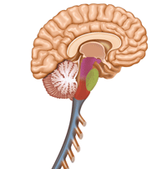
The CNS processes information.
The brain has three parts.
cerebrum controls thought, movement, emotion
cerebellum allows for balance
brain stem controls basic life functions
midbrain
Brain stem
pons
medulla oblongata

Slide 5
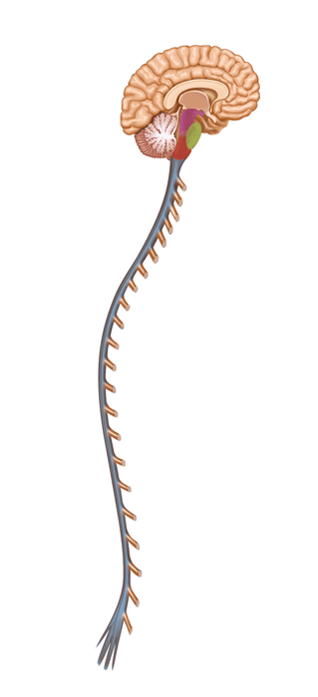
The brain stem has three parts.
midbrain controls some reflexes
pons regulates breathing
medulla oblongata controls heart function, swallowing, coughing
midbrain
pons
medulla oblongata

Slide 6
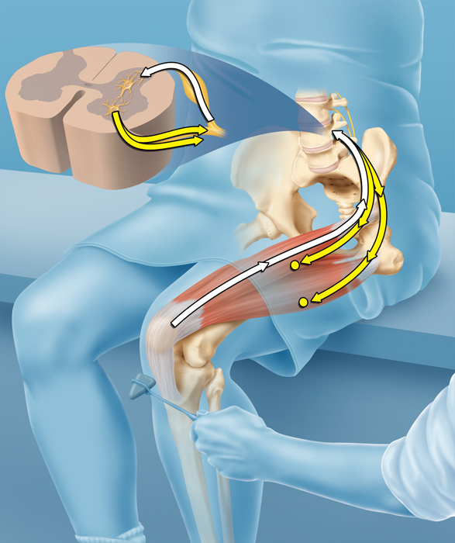
The spinal cord controls reflexes.
sensory neuron sends impulse to spinal cord
spinal cord directs impulse to motor neuron
does not involve the brain
interneuron
motor neurons
sensory neuron

Slide 7
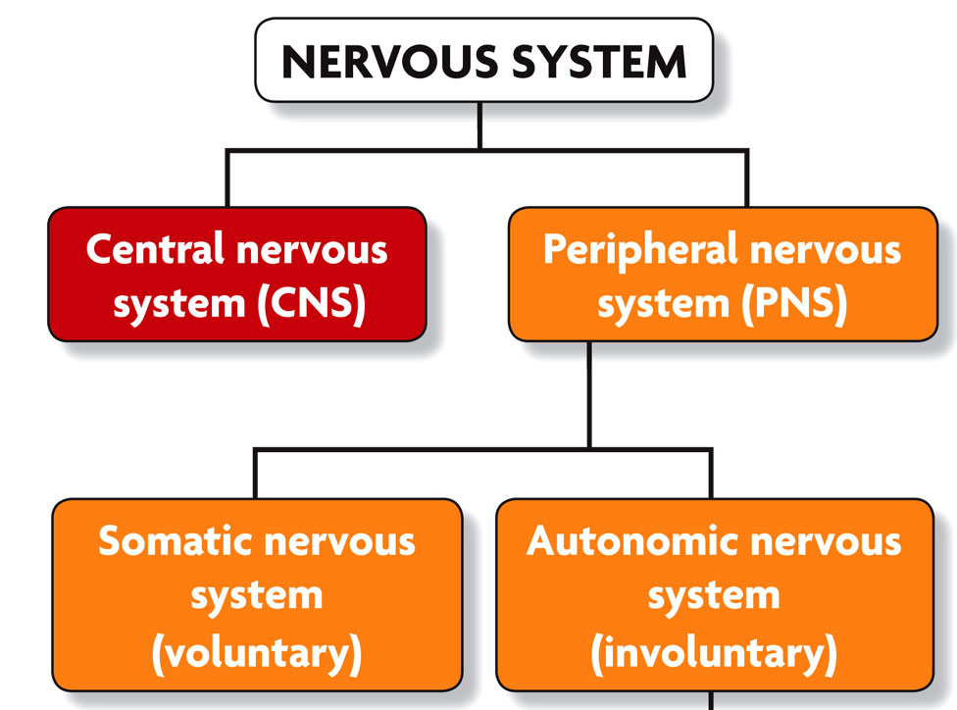
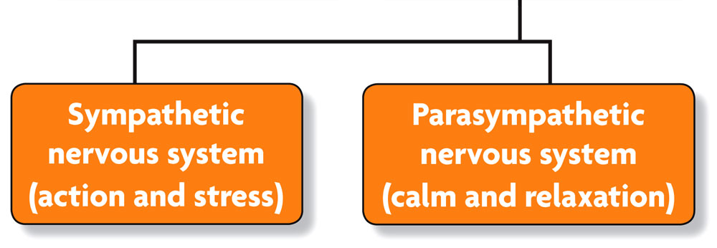
The PNS links the CNS to muscles and other organs.
The somatic nervous system regulates voluntary movements.
The autonomic nervous system controls involuntary, functions
sympathetic nervous system: “fight vs. flight”
parasympathetic nervous system: calms the body, conserves energy

