Slide 1
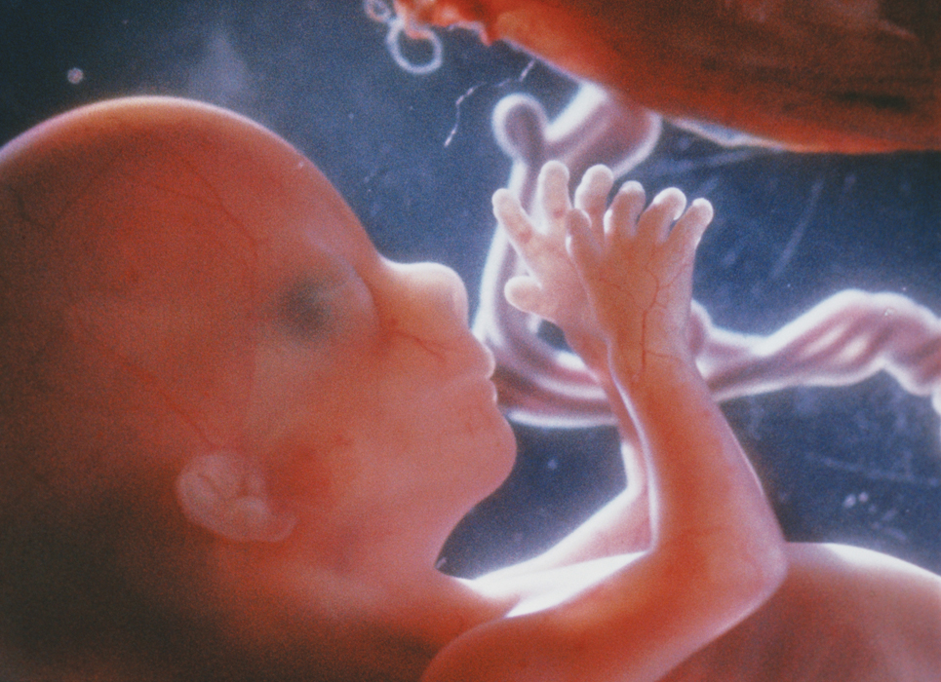
KEY CONCEPT Development progresses in stages from zygote to fetus.

Slide 2
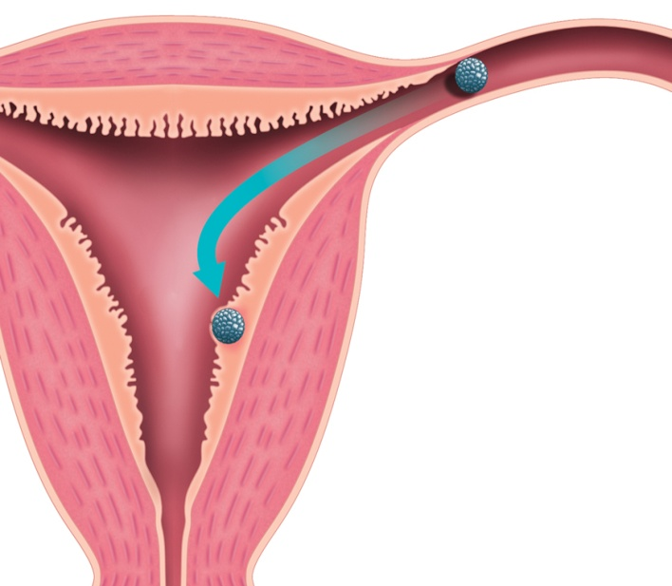
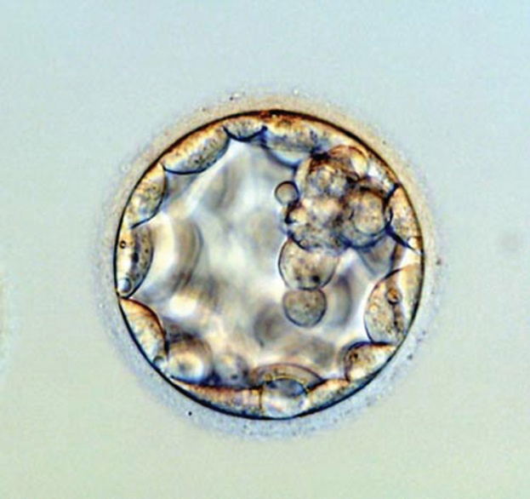
The fertilized egg implants into the uterus and is nourished by the placenta and umbilical cord.
The zygote becomes a blastocyst and implants in the uterus.
ectoderm develops into skin and nervous system
mesoderm develops into Internal tissues and organs
endoderm develops into digestive organs and their lining
blastocyst
uterine wall
Implantation of blastocyst

Slide 3
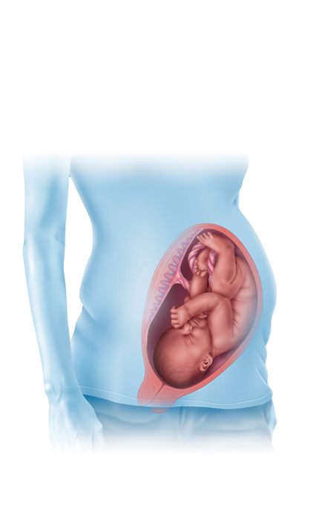
The blastocyst becomes an embryo.
Embryonic membranes protect and nourish the embryo.
amniotic sac cushions embryo.
placenta connects mother and embryo.
umbilical cord connects embryo to placenta.
placenta
umbilical cord
uterus
amniotic sac

Slide 4
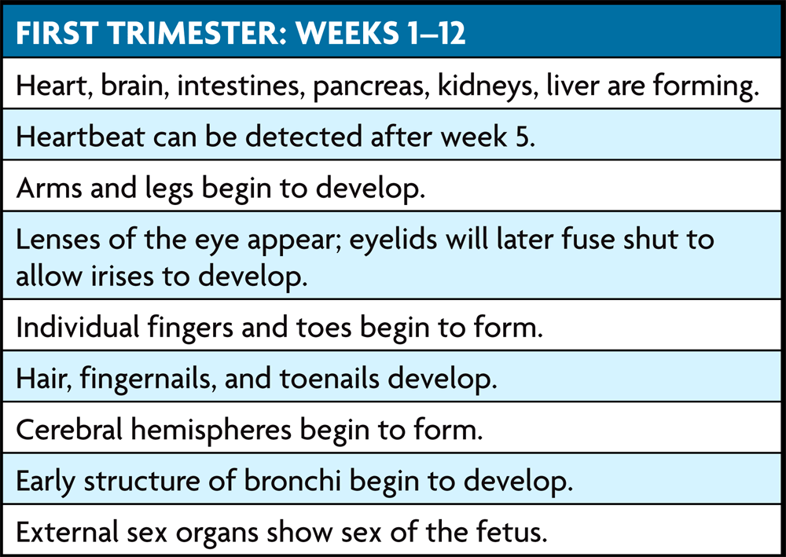
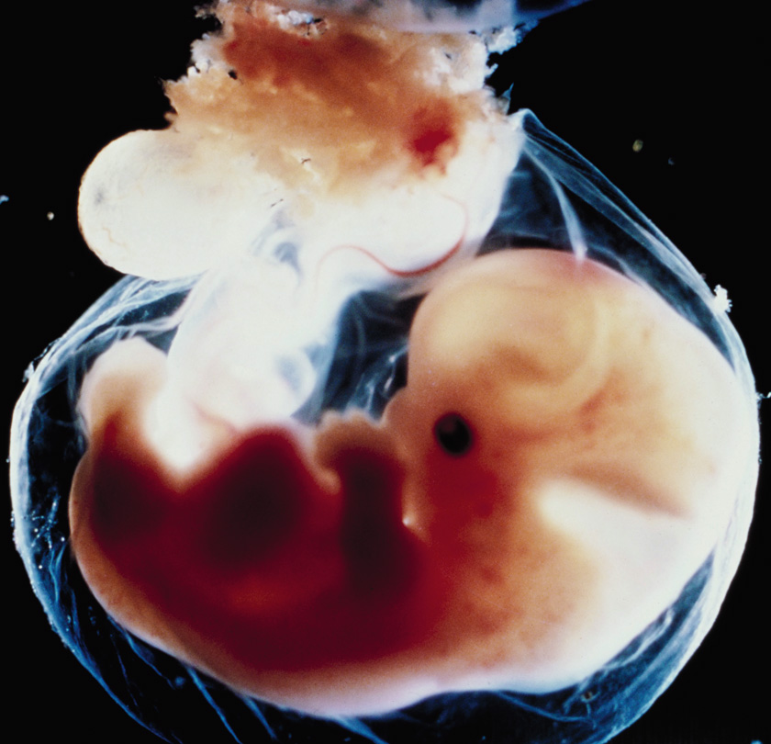
A zygote develops into a fully formed fetus in about 38 weeks.
Human pregnancies are divided into trimesters.
1st trimester: body plan and early development

Slide 5
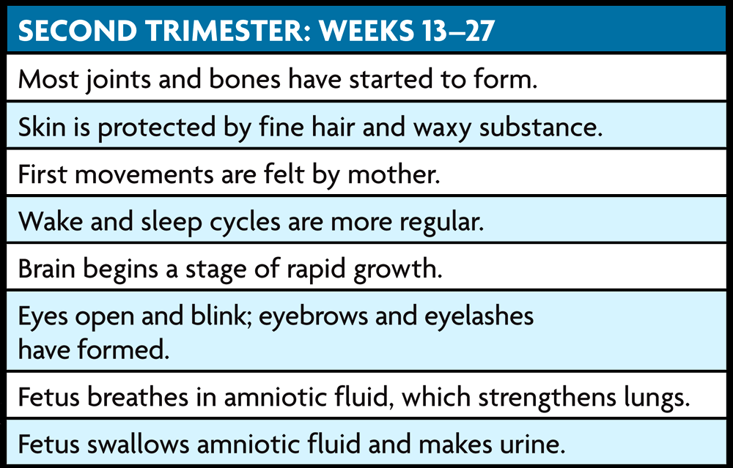
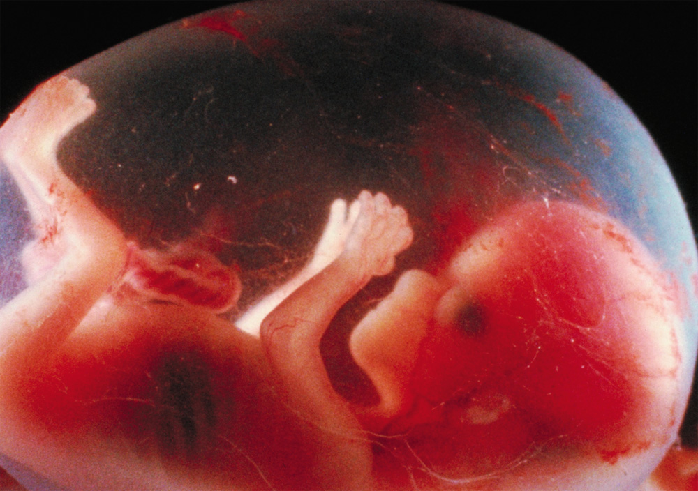
2nd trimester: fetus more active, developed

Slide 6
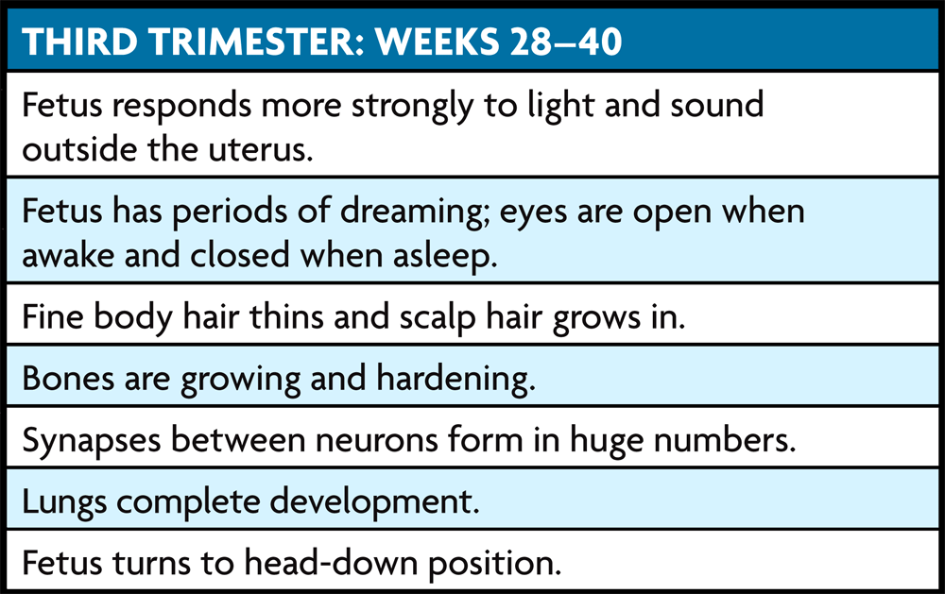
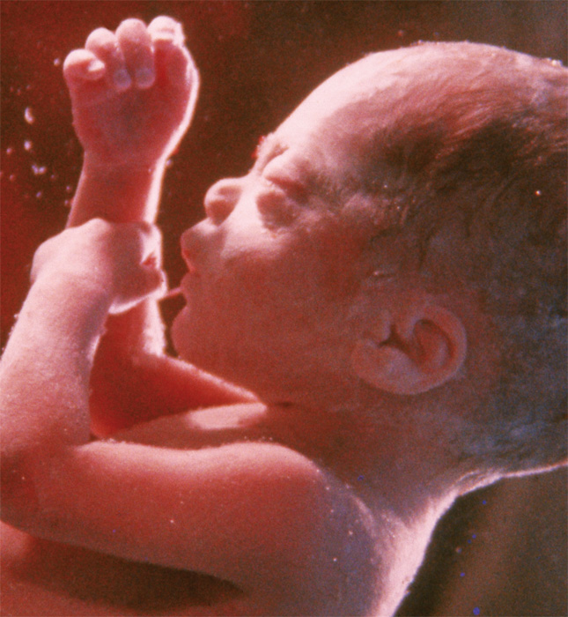
3rd trimester: all organs fully formed
After about 38 weeks, fetus is ready to be born.

Slide 7
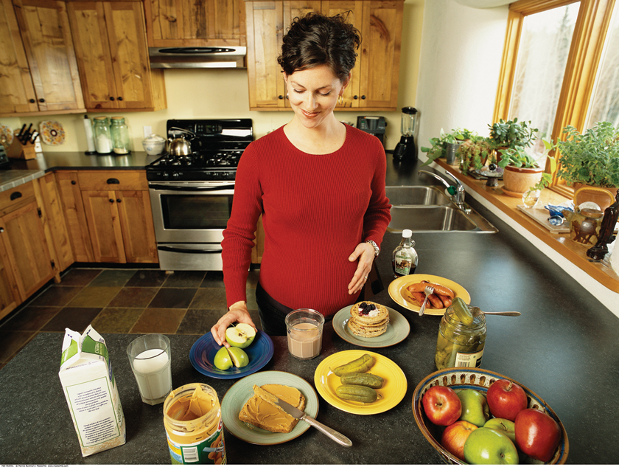
The mother affects the fetus, and pregnancy affects the mother.
The fetus depends on the mother for all its nutrition.
mother's diet must support fetal health
mother must avoid toxic chemicals

Slide 8
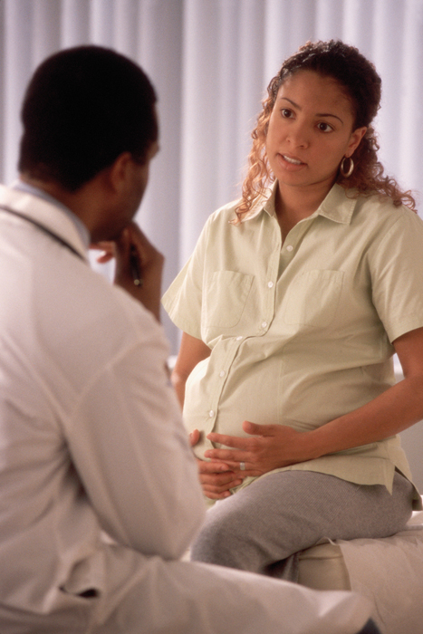
The mother’s health is affected by pregnancy in a number of ways.
increase in Calories and body weight
pregnancy hormones affecting homeostasis
regular medical checkups needed

