Slide 1
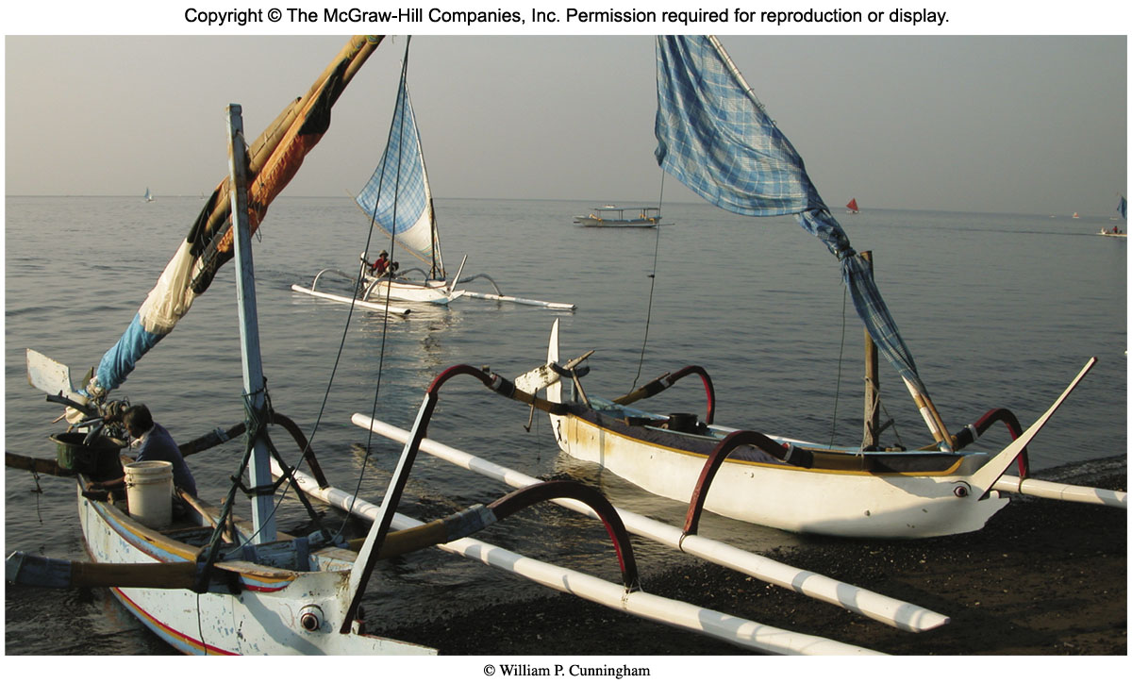
Biomes: Global Patterns of Life

Slide 2
Outline
Terrestrial Biomes
Marine Ecosystems
Open Ocean
Shallow Coasts
Freshwater Ecosystems
Lakes
Wetlands
Human Disturbance

Slide 3
Terrestrial Biomes
Biomes - areas sharing similar climate, topographic and soil conditions, and thus the same basic types of biological communities.
Temperature and precipitation are among the most important determinants in biome distribution.
Many temperature-controlled biomes occur in latitudinal bands.

Slide 4
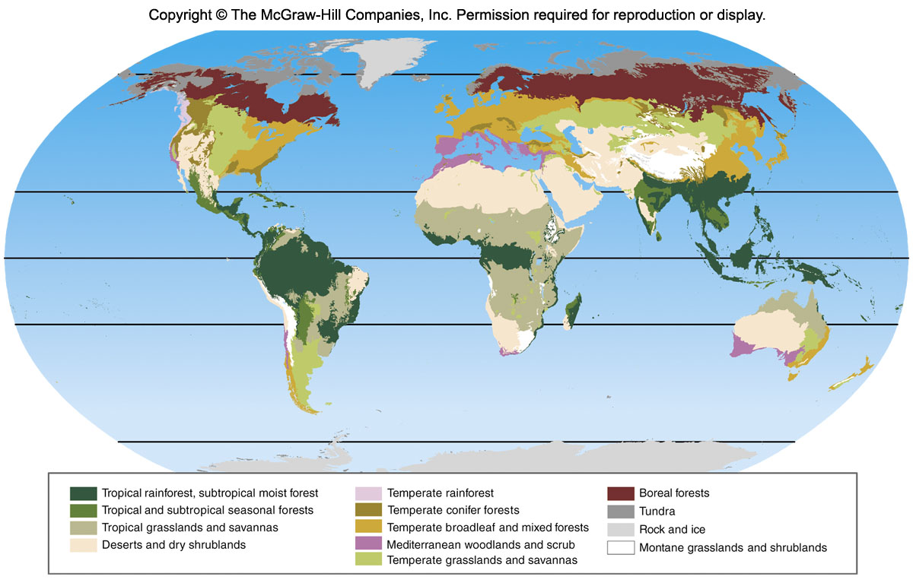
Biomes

Slide 5
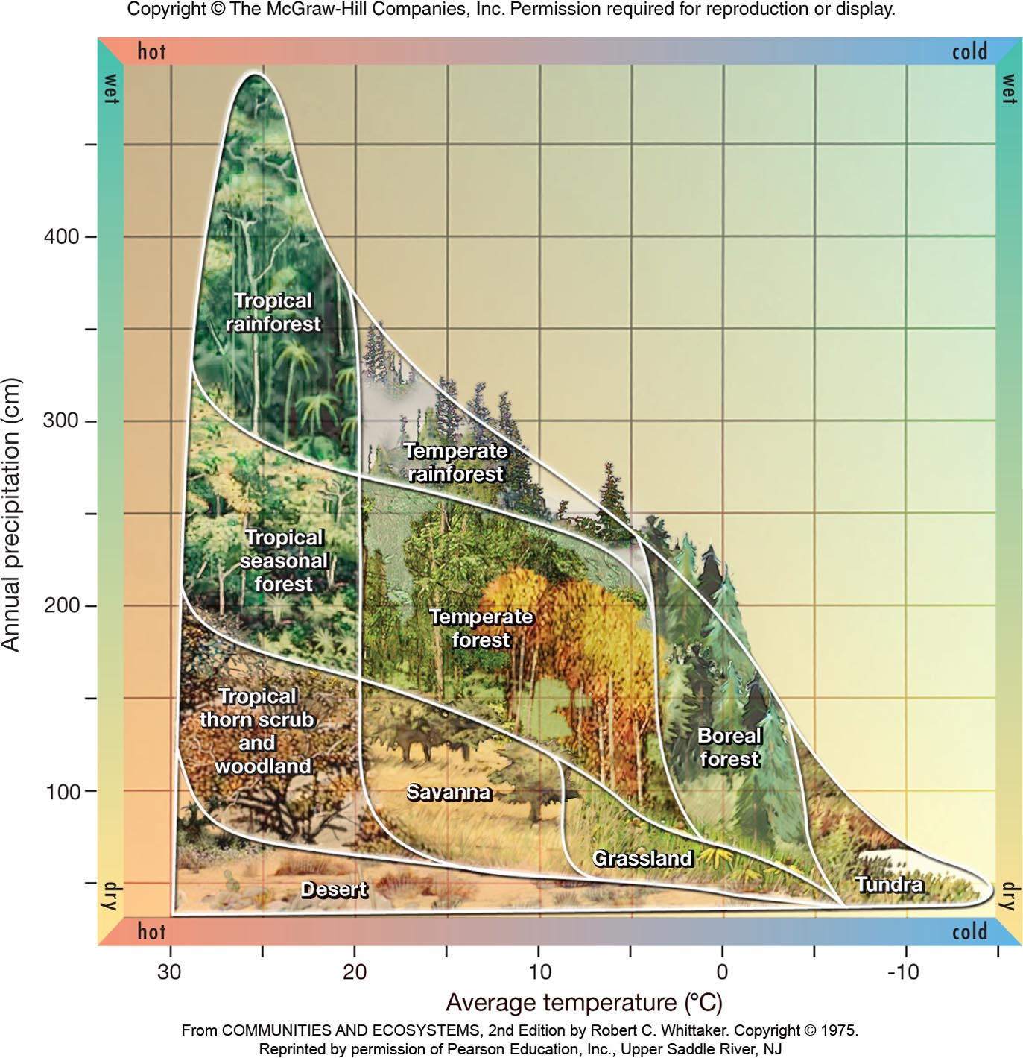

Slide 6
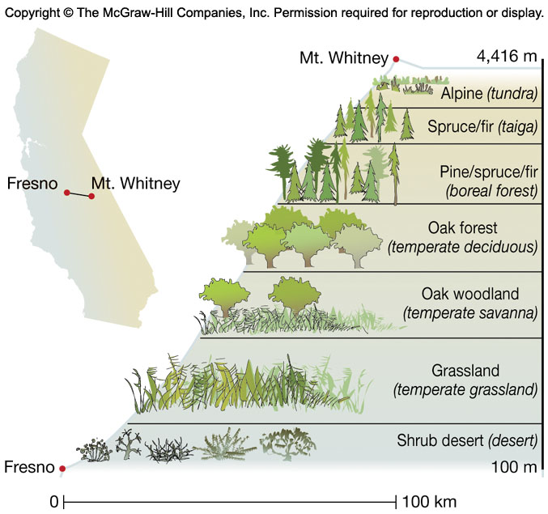
Biomes
Temperature and precipitation also change with altitude. As you go up a mountain, it gets cooler and wetter. Vertical zonation is a term applied to vegetation zones defined by altitude.

Slide 7
Rainforests
Humid tropical regions support one of the most complex and biologically rich biomes.
Ample rainfall and uniform temperatures
Cloud Forests - high mountains where fog and mist keep vegetation continually wet
Tropical rainforests - occur where rainfall exceeds 200 cm (80 inches) per year and temperatures are warm to hot year round

Slide 8
Rainforests
Soil in rainforests tends to be thin and nutrient poor.
90% nutrients tied up in living organisms
Rapid decomposition and nutrient cycling
Thin soil cannot support continued cropping and cannot resist erosion.
Rapid deforestation occurring as people move into the forests
One half to two thirds of all the species of terrestrial plants and animals live in tropical forests.

Slide 9
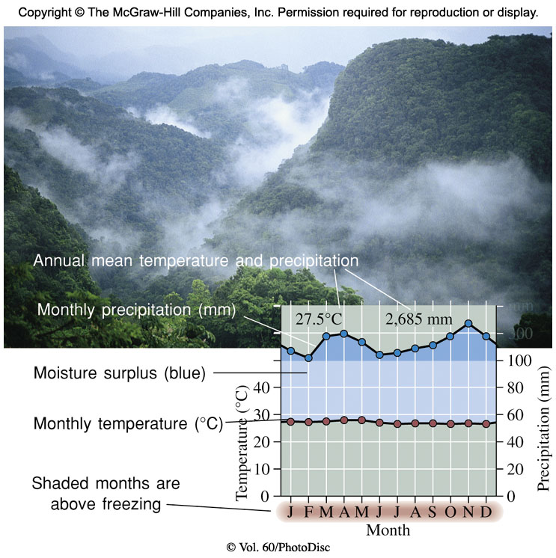
Tropical Rainforests

Slide 10
Tropical Seasonal Forests
Many tropical regions are characterized by wet and dry seasons with hot temperatures year round. These support tropical seasonal forests.
Dry and brown much of the year but become green during the rainy season
Many of the plants are drought deciduous; they lose their leaves when it is dry.
Few of the tropical seasonal forests remain in their natural state as humans use fire to clear the land in the dry season and settle there.

Slide 11
Tropical Savannas and Grasslands
Grasslands with sparse tree cover are called savannas.
Too little rainfall to support forests
Dry season prone to fire
Plants with deep, long-lived roots and other adaptations to survive drought, heat, and fire
Many migratory grazers such as antelope, wildebeest, or bison

Slide 12
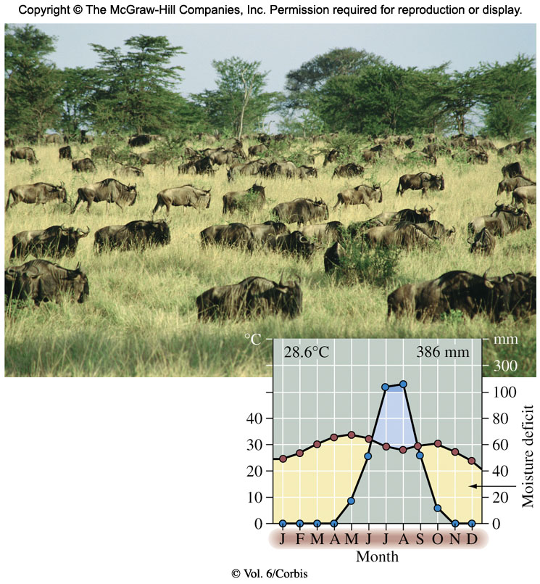
Tropical Savannas and Grasslands

Slide 13
Deserts
Characterized by low moisture levels (less than 30 cm per year) and precipitation that is infrequent and unpredictable from year to year. Deserts have wide daily and seasonal temperature fluctuations.
Plants exhibit water conservation characteristics such as water-storing stems, thick epidermis to reduce water loss, and salt tolerance.

Slide 14
Deserts
Animals also have adaptations. Many are nocturnal and able to conserve water.
Deserts are vulnerable.
Slow growing vegetation is damaged by off road vehicles. It takes decades for desert soils to recover.
Overgrazing - Livestock are destroying the plants of the southern Sahara. Without plants the land cannot retain what little rainfall there is and it becomes more barren.

Slide 15
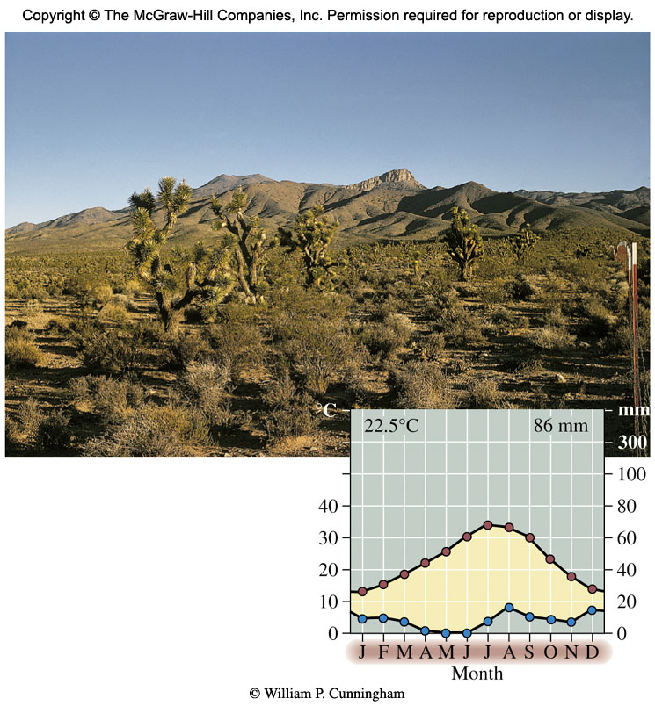
Deserts

Slide 16
Temperate Grasslands
Communities of grasses and seasonal herbaceous flowering plants
Few trees due to inadequate rainfall
Large daily and seasonal temperature fluctuations
Thick organic soils
Much converted to farmland. The prairies in the U.S. are now farms.
Overgrazing is a threat because it kills the plants and permits erosion to occur.

Slide 17
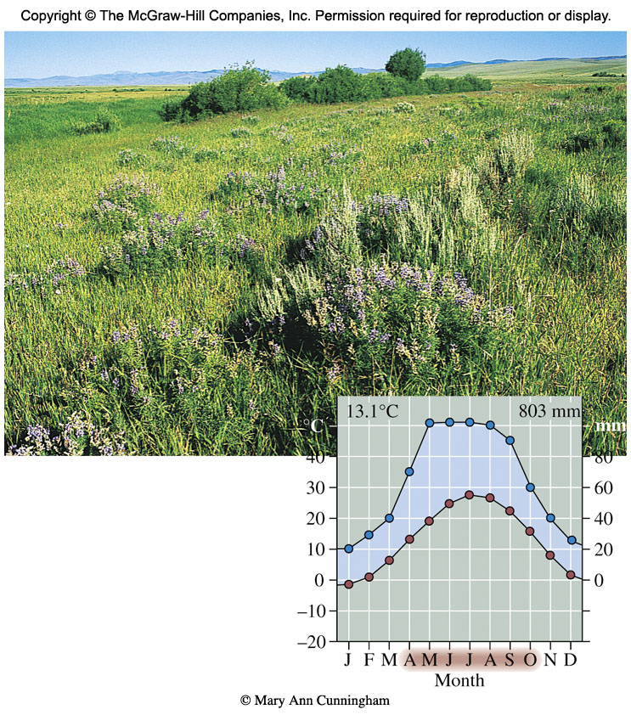
Grasslands

Slide 18
Mediterranean or Temperate Shrubland
Characterized by warm, dry summers and cool, moist winters
Evergreen shrubs, scrub oaks, pines
Fires are a major factor in plant succession.
Referred to as chaparral in California
High biodiversity
Human homes built in chaparral harm endangered wildlife and burn periodically.
Also found along Mediterranean coast, southwestern Australia, Chile and South Africa

Slide 19
Deciduous Forest
Temperate regions support lush summer plant growth when water is plentiful.
Deciduous trees lose their leaves in winter as an adaptation to freezing temperatures.
Eastern half of U.S. was covered with broad leaf deciduous forest when European settlers arrived. Much of that was harvested for timber.
Areas in U.S. have re-grown, although the dominant species are different
Areas in Siberia severely threatened now

Slide 20
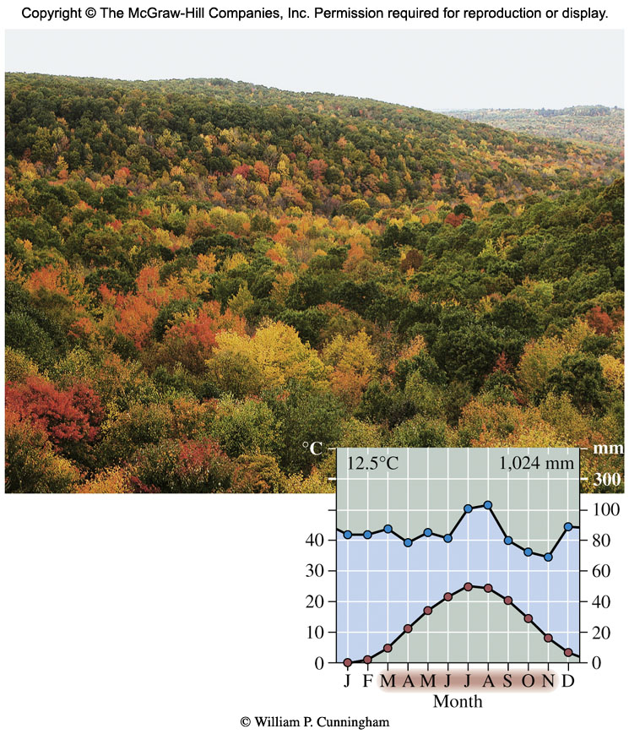
Temperate Deciduous Forests

Slide 21
Temperate Coniferous Forests
Often occur where moisture is limited
Plants reduce water loss by evolving thin, needle-like evergreen leaves with thick waxy coating.
Can survive harsh winters or extended droughts and accomplish photosynthesis even under poor conditions
Source of most wood products in North America

Slide 22
Coniferous Forests
Temperate rainforest - wet, foggy forests of the Pacific coast. Up to 250 cm (100 inches) of rain per year.
Mild temperatures year-round
Redwood forests fall into this category.
Conservation battle to save the remnants of these old growth forests
Boreal Forest - Northern Coniferous Forest
Broad band of mixed coniferous and deciduous trees between 50° and 60° N latitude
Dominated by pines, hemlock, spruce, cedar and fir with some deciduous trees mixed in

Slide 23
Boreal Forests
Taiga - Northernmost edge of boreal forest
Species-poor. Harsh climate limits productivity and resilience.
Extreme cold and short summers limit the growth rate of trees. A tree that is 4 inches (10 cm) in diameter may be over 200 years old.

Slide 24
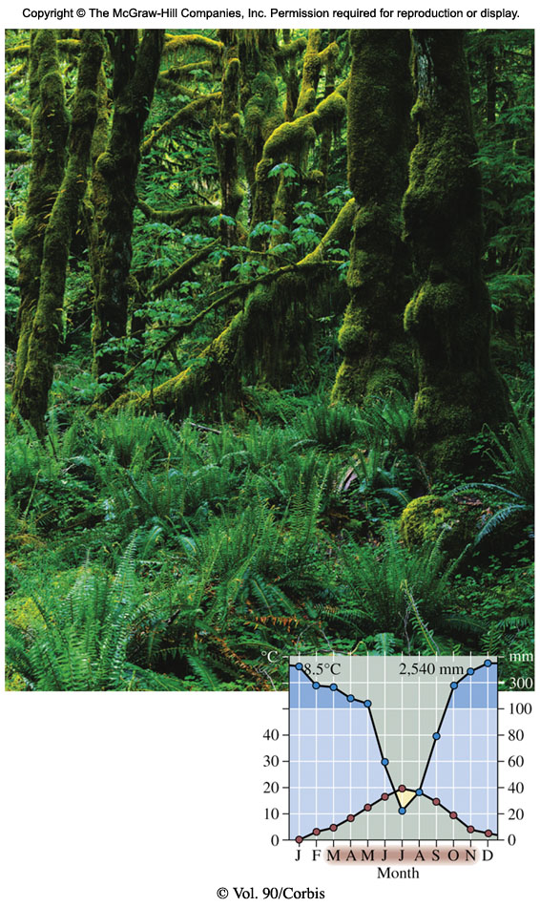
Temperate Rainforest

Slide 25
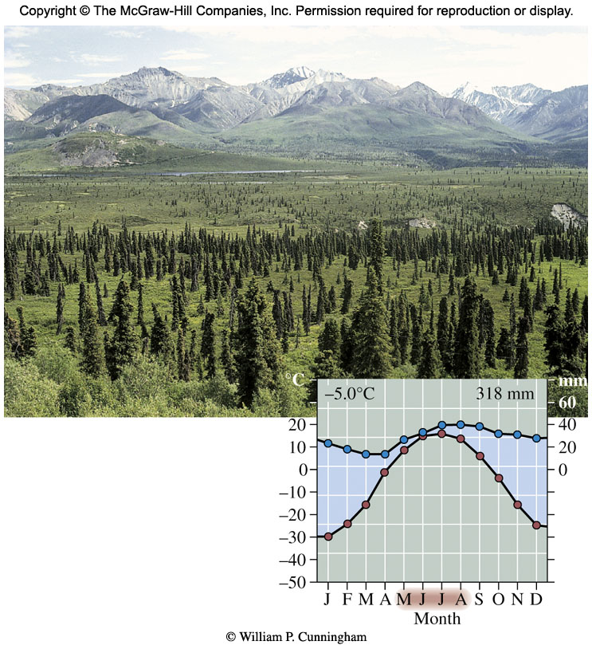
Boreal Forest

Slide 26
Tundra
Treeless
Two to three month growing season, with cold harsh winters
Arctic Tundra exhibits low productivity, but during midsummer supports migratory birds by the millions.
Alpine Tundra occurs on or near mountaintops
Vegetation similar to arctic tundra
Relatively low biodiversity
Threatened by global warming and oil drilling in Alaska and Siberia

Slide 27
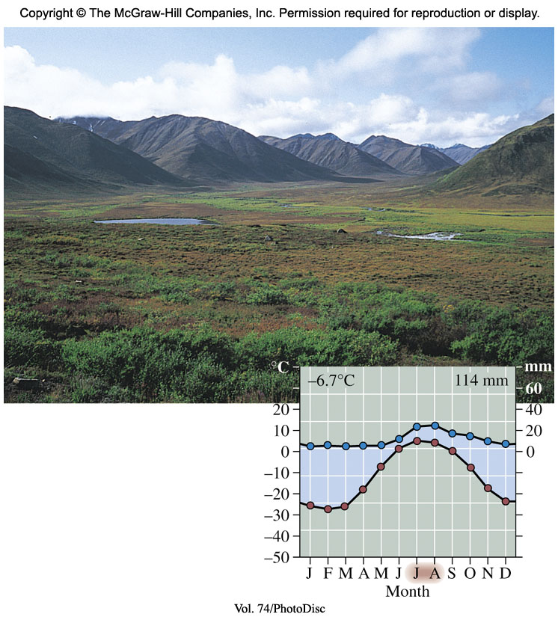
Tundra

Slide 28
Marine Ecosystems
Oceans cover 3/4 of Earth’s surface.
Photosynthesis is carried out by algae or free floating plants (phytoplankton). Greatest amount of photosynthesis near the coast where nutrients wash in.
Organisms die and fall to sea floor where the nutrients are used in deep ocean ecosystems.
Upwelling currents circulate nutrients from the ocean floor back to the surface.

Slide 29
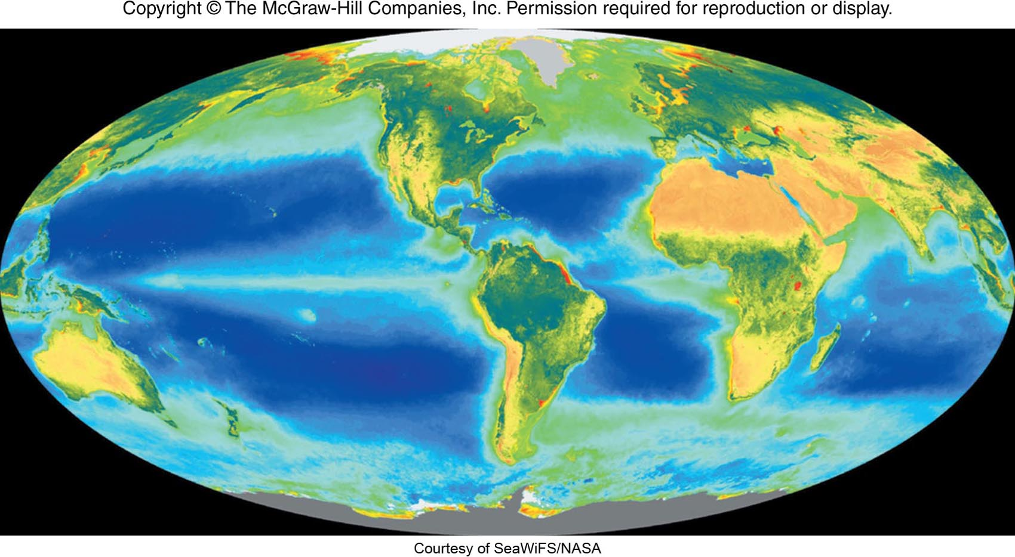

Slide 30
Marine Ecosystems
Vertical stratification is a key feature.
Light and temperature decrease with depth and deep ocean species often grow slowly.
Cold water holds more oxygen than warm water so productivity is often high in cold oceans such as the North Atlantic.
Ocean systems classified:
Benthic - bottom
Pelagic - water column above the bottom
Area near shore is known as littoral zone

Slide 31
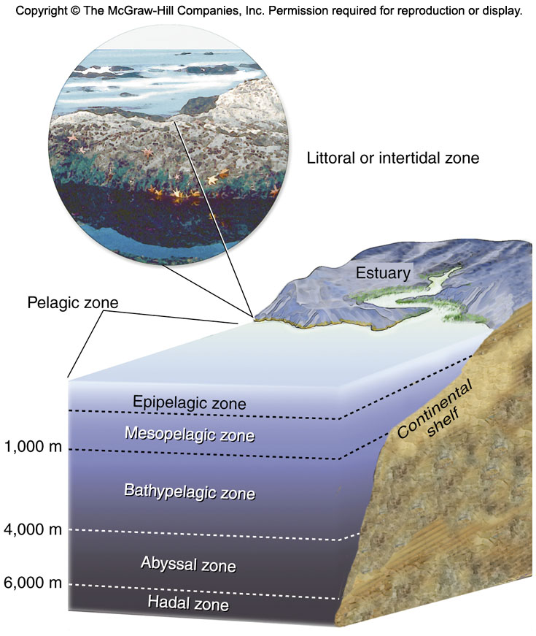
Zones of the Ocean

Slide 32
Surface to Hadal Zone Communities
Open ocean is a biological desert except for areas where nutrients are distributed by currents e.g. Sargasso Sea in the Atlantic
The deepest layer of the ocean (hadal zone) contains communities of tube worms, mussels, etc. supported by microbes that capture chemical energy from thermal vents on the ocean floor. These organisms are adapted to extreme temperatures (700 degrees F) and intense pressure.

Slide 33
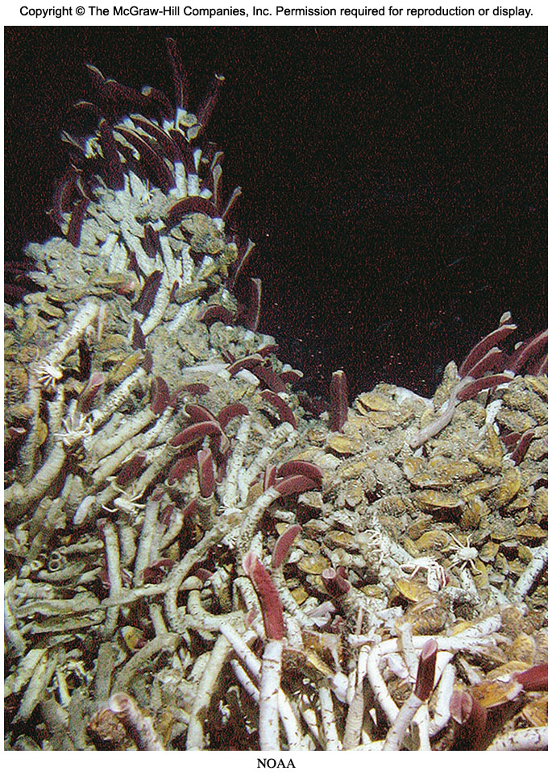
Thermal Vent Community

Slide 34
Coastal Zones
Communities vary with depth, light, temperature and nutrient concentration.
Coral Reefs - Aggregations of coral polyps that live symbiotically with algae. Their calcium rich skeletons build up the reef.
Light must penetrate for algal photosynthesis.
Threatened by trash, sewage, urban runoff, industrial waste, introduced pathogens and global warming. Global warming causes coral bleaching in which corals expel their algal partners and then die.
One third of coral reefs have already been destroyed and 60% of the remaining reefs will probably be dead by 2030 ( 2006 UNESCO Conference).

Slide 35
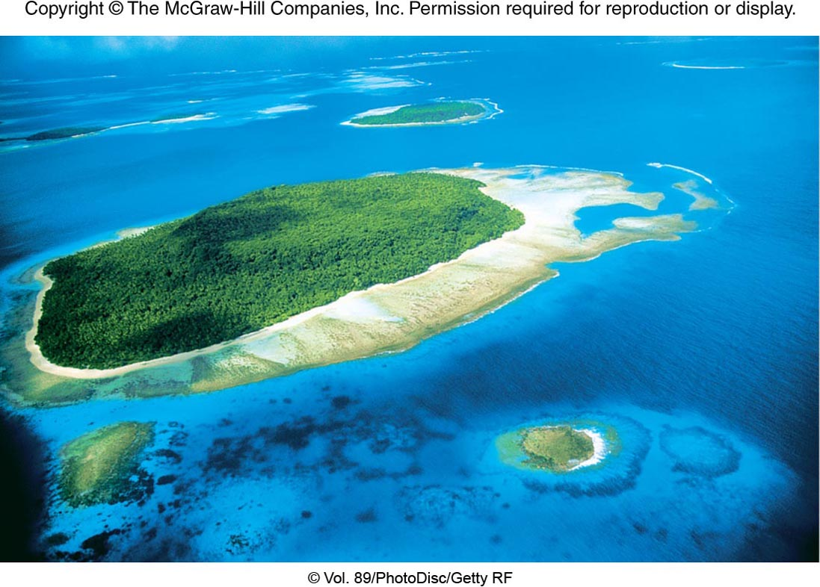

Slide 36
Mangroves
Mangroves are trees that grow in saltwater along tropical coastlines.
Help stabilize shoreline
Nurseries for fish, shrimp
Can be cut for timber

Slide 37
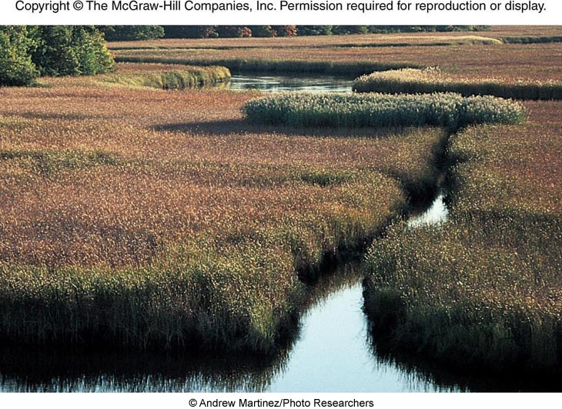
Tidal Environments
Estuaries - bays or semi-enclosed bodies of brackish water that form where rivers enter the ocean
Salt marshes - coastal wetlands flooded regularly or occasionally by seawater
Both are nutrient rich and biologically diverse.
2/3 of marine fish and shellfish rely on estuaries for spawning and development.
Threatened by sewage from coastal cities

Slide 38
Tide Pools
Depressions in a rocky shoreline that are flooded at high tide but retain some water at low tide
Wave action prevents plant growth, but animals can be found in tidal pools.

Slide 39
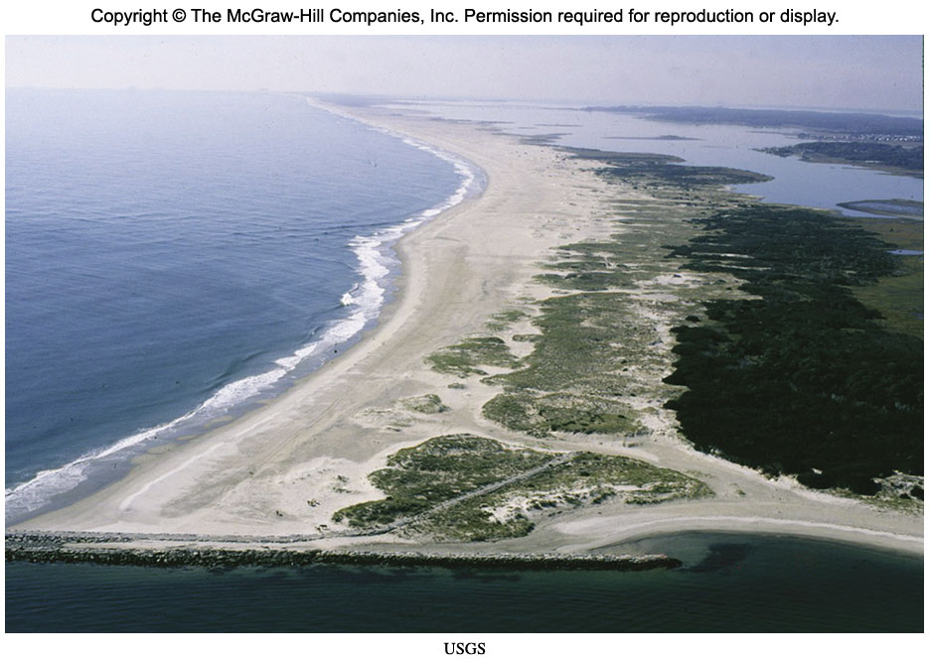
Barrier Islands
Narrow islands made of sand that form parallel to a coastline
Provide protection from storms, waves, tides
Since they are made of sand, they should not be built on, but they are. Oftentimes, storms destroy the buildings.

Slide 40
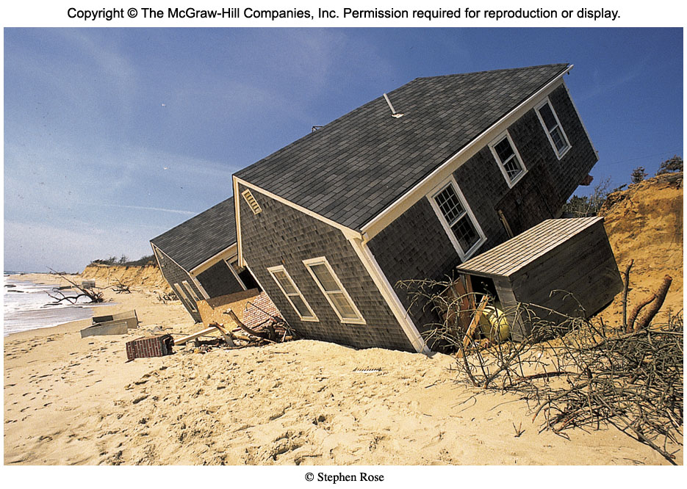
Storm Erosion on a Barrier Island

Slide 41
Freshwater Ecosystems
Lakes
Freshwater lakes have distinct vertical zones.
Epilimnion - warm upper layer
Hypolimnion - cold, deeper layer that does not mix
Thermocline - distinctive temperature transition zone that separates warm upper layer and deeper cold layer
Benthos - bottom

Slide 42
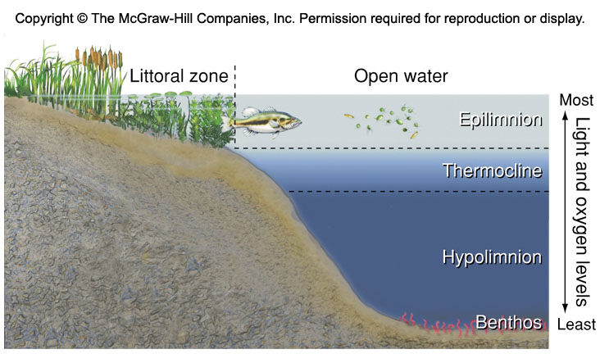
Layers of a Lake

Slide 43
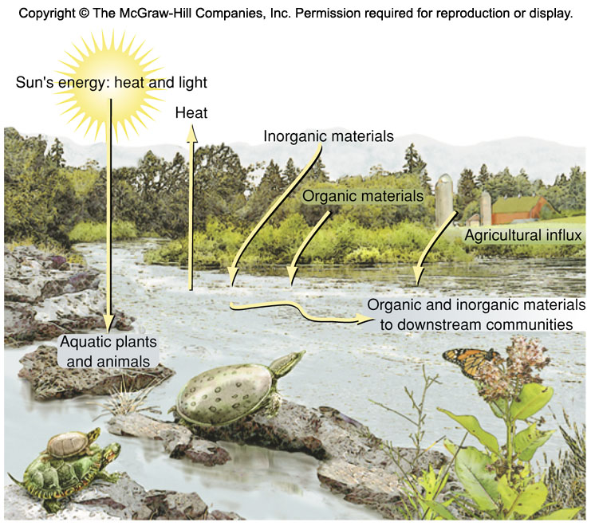
Terrestrial Ecosystems Influence a Lake

Slide 44
Wetlands
Land surface is saturated or covered with water at least part of the year.
Swamps - Wetlands with trees.
Marshes - Wetlands without trees.
Bogs and Fens - Waterlogged soils that tend to accumulate peat. Bogs fed by precipitation, while fens are fed from groundwater. Nutrient poor with low productivity, but many unusual species.
Water usually shallow enough to allow full sunlight penetration, so the majority of wetlands have high productivity.
Trap and filter water, and store runoff.

Slide 45
Wetlands
Conservation is very important due to rich biodiversity. Wetlands are the breeding grounds for birds. Make up less than 5% of land area, but contain 33% of endangered species. One of the greatest areas of concern for biologists.
May gradually convert to terrestrial communities through succession

Slide 46
Wetlands

Slide 47
Human Disturbance
By some estimates, humans preempt about 40% of net terrestrial primary productivity.
Conversion of habitat to human use is single largest cause of biodiversity loss.
Temperate deciduous forests are the most completely human-dominated biome. Tundra and Arctic Deserts are the least disturbed.
About half of all original wetlands in the U.S. have been degraded over the past 250 years.

Slide 48
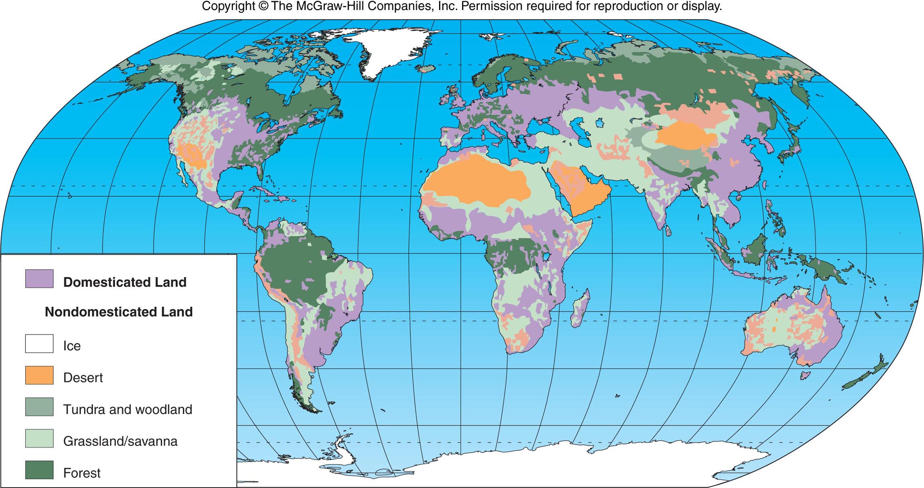

Slide 49
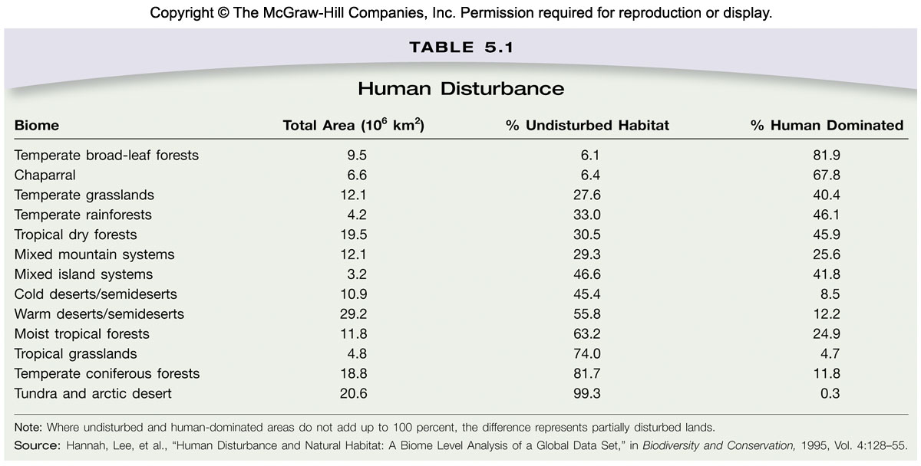
Human Disturbance

