Slide 1
Echinodermata
By The Brodmonster and Hunter

Slide 2
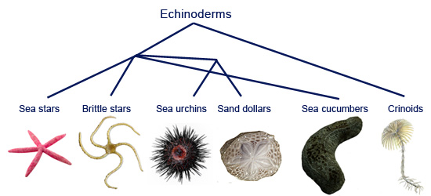
Phylum Introduction
Echinodermata are invertebrates who have hard and spiny skin.

Slide 3
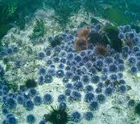
Details
Habitat: Spread across the ocean and lives in almost all depths and environments.
Reproduction: usually external fertilization, but some species use fragmentation.
Feeding Strategies: Filter Feeding, (collecting food particles filtered from the water) Suspension, (uses arms to collect food particles) and deposit feeders. (go through sediment to get food)
Predator/Prey relationship: Sea Urchins eat kelp
Symmetry: Radial Symmetry
https://www.youtube.com/watch?v=Fp0ThW2dsUI

Slide 4
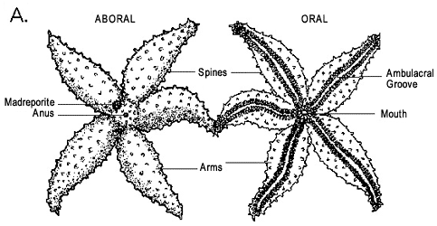
Diagram

Slide 5
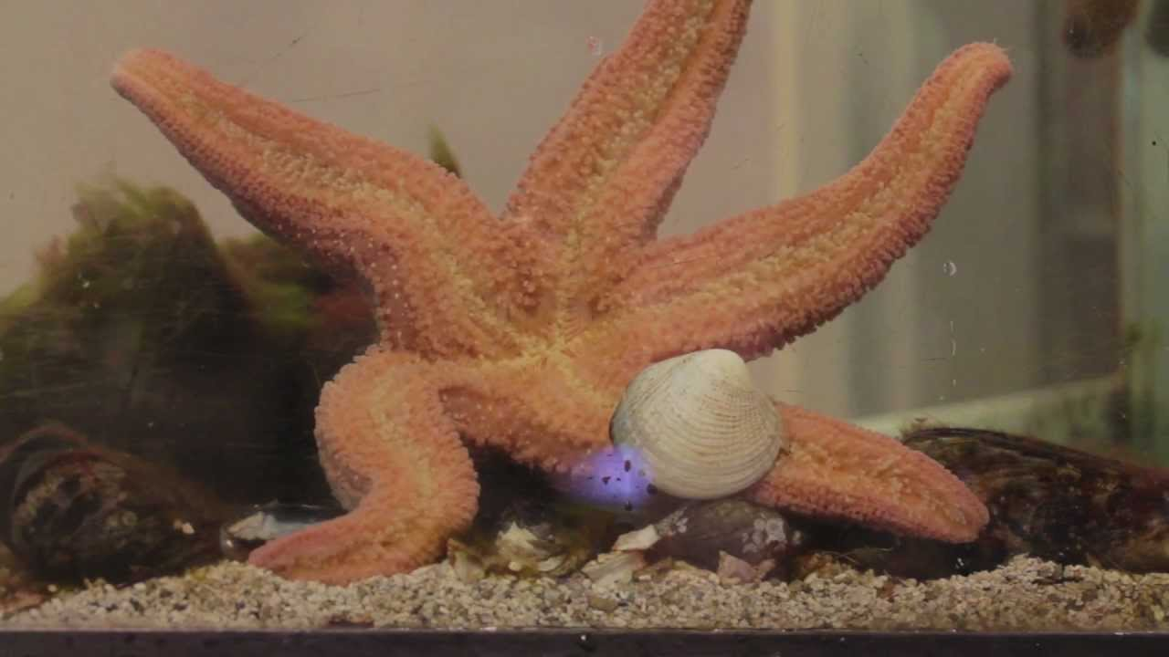
Adaptations
Adaptation 1: rows of spines for protection against predators
Adaptation 2: regeneration of limbs (starfish)
Adaptation 3: suction tube feet to pry open shells
https://www.youtube.com/watch?v=45IdcMearfU

Slide 6
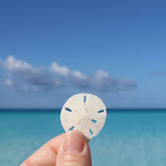
Animals
Sea Urchin
Sea Urchins are grazers. They live on the sea floor, and they are small, round, and spiny.
Starfish
Starfish have a central disc with usually 5 arms. They have no brain or blood
Sand Dollar
Sand Dollars have a flat disc-shaped body, and they are well adapted to burrowing in the sand. They are close relatives to Sea Urchins.

Slide 7
Human Impact
Negative Impact 1: Harvested to eat
Negative Impact 2: Taken out of natural habitat for pet or aquarium use

Slide 8
Closing thoughts
Echinoderms are mad underrated; they are so cool.
bye

Slide 9
Activity Time: Four Corners
What characteristics define Echinodermata?
1st corner: vertebrate who have soft skin
2nd corner: vertebrate with hard, spiny skin
3rd corner: invertebrate with soft skin
4th corner: invertebrate with hard, spiny skin

Slide 10
answer
4th one: invertebrate with hard, spiny skin

Slide 11
Echinoderms are
1st corner: radially symmetrical
2nd corner: asymmetrical
3rd corner: spherical symmetry
4th corner: boss symmetry

Slide 12
answer
4th corner: boss symmetry

Slide 13
You are dumb if you actually thought it was boss symmetry
1st corner: radially symmetrical

Slide 14
What adaptation helps starfish eat clams?
1st corner: spiny skin
2nd corner: suction tube feet
3rd corner: regeneration of limbs

Slide 15
answer
2nd corner: suction tube feet

Slide 16
Which one of these is NOT an echinoderm?
1st corner: starfish
2nd corner: sand dollar
3rd corner: lobster
4th corner: sea urchin

Slide 17
answer
3rd corner: lobster

Slide 18
Which of these is NOT an adaptation of Echinoderms?
1st corner: spiny skin to protect themselves from predators
2nd corner: ability to be immortal
3rd corner: ability to regenerate limbs
4th corner: suction tube feet to pry open shells

Slide 19
answer
2nd corner: ability to be immortal

