Slide 1
Marine Arthropods
By: Hunter Johnston

Slide 2
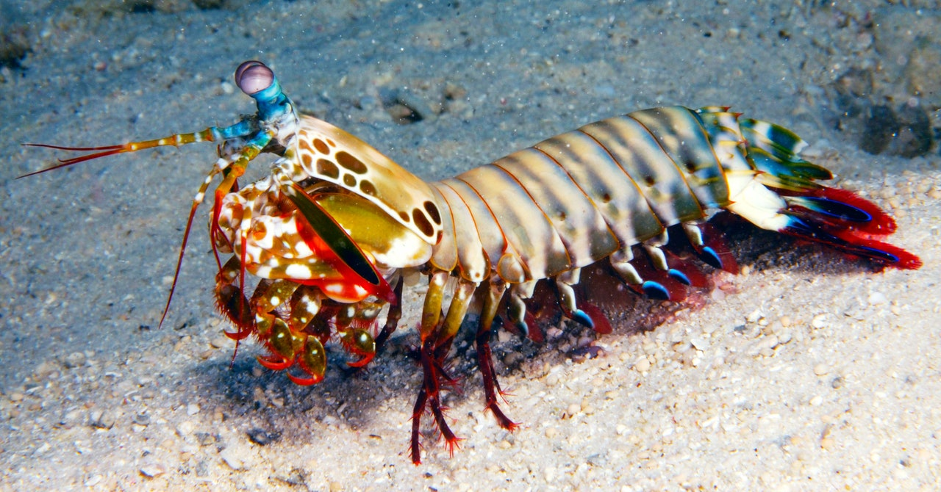
Phylum introduction
Marine arthropods are all the animals with shells such as, blue crab, horseshoe crab, shrimp, mantis shrimp, etc.
Marine arthropods are defined by their segmented bodies, jointed legs, and a hard exoskeleton

Slide 3
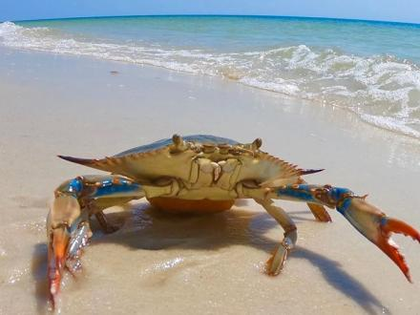
Marine arthropods habitat
Arthropods can survive in nearly any habitat, in fact different species can live on land, water, or a combination of both
Aquatic arthropods are usually found in coastal habitats like sandy beaches and intertidal areas but can even live comfortably in the deep sea

Slide 4
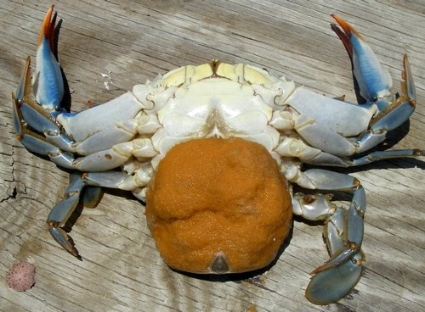
Reproduction
Arthropods usually reproduce sexually through external fertilization or, more uncommonly, asexually in cases where both male and female reproductive organs are present in one organism. External fertilization occurs when a male arthropod encases its sperm in a pouch that is deposited directly into a female arthropod or sent free to be taken up by a female
The offspring of most species of arthropods begin as eggs, then hatch from these and enter a larval stage. In many arthropods, such as crabs, you can see these eggs attached to the hard abdomen

Slide 5
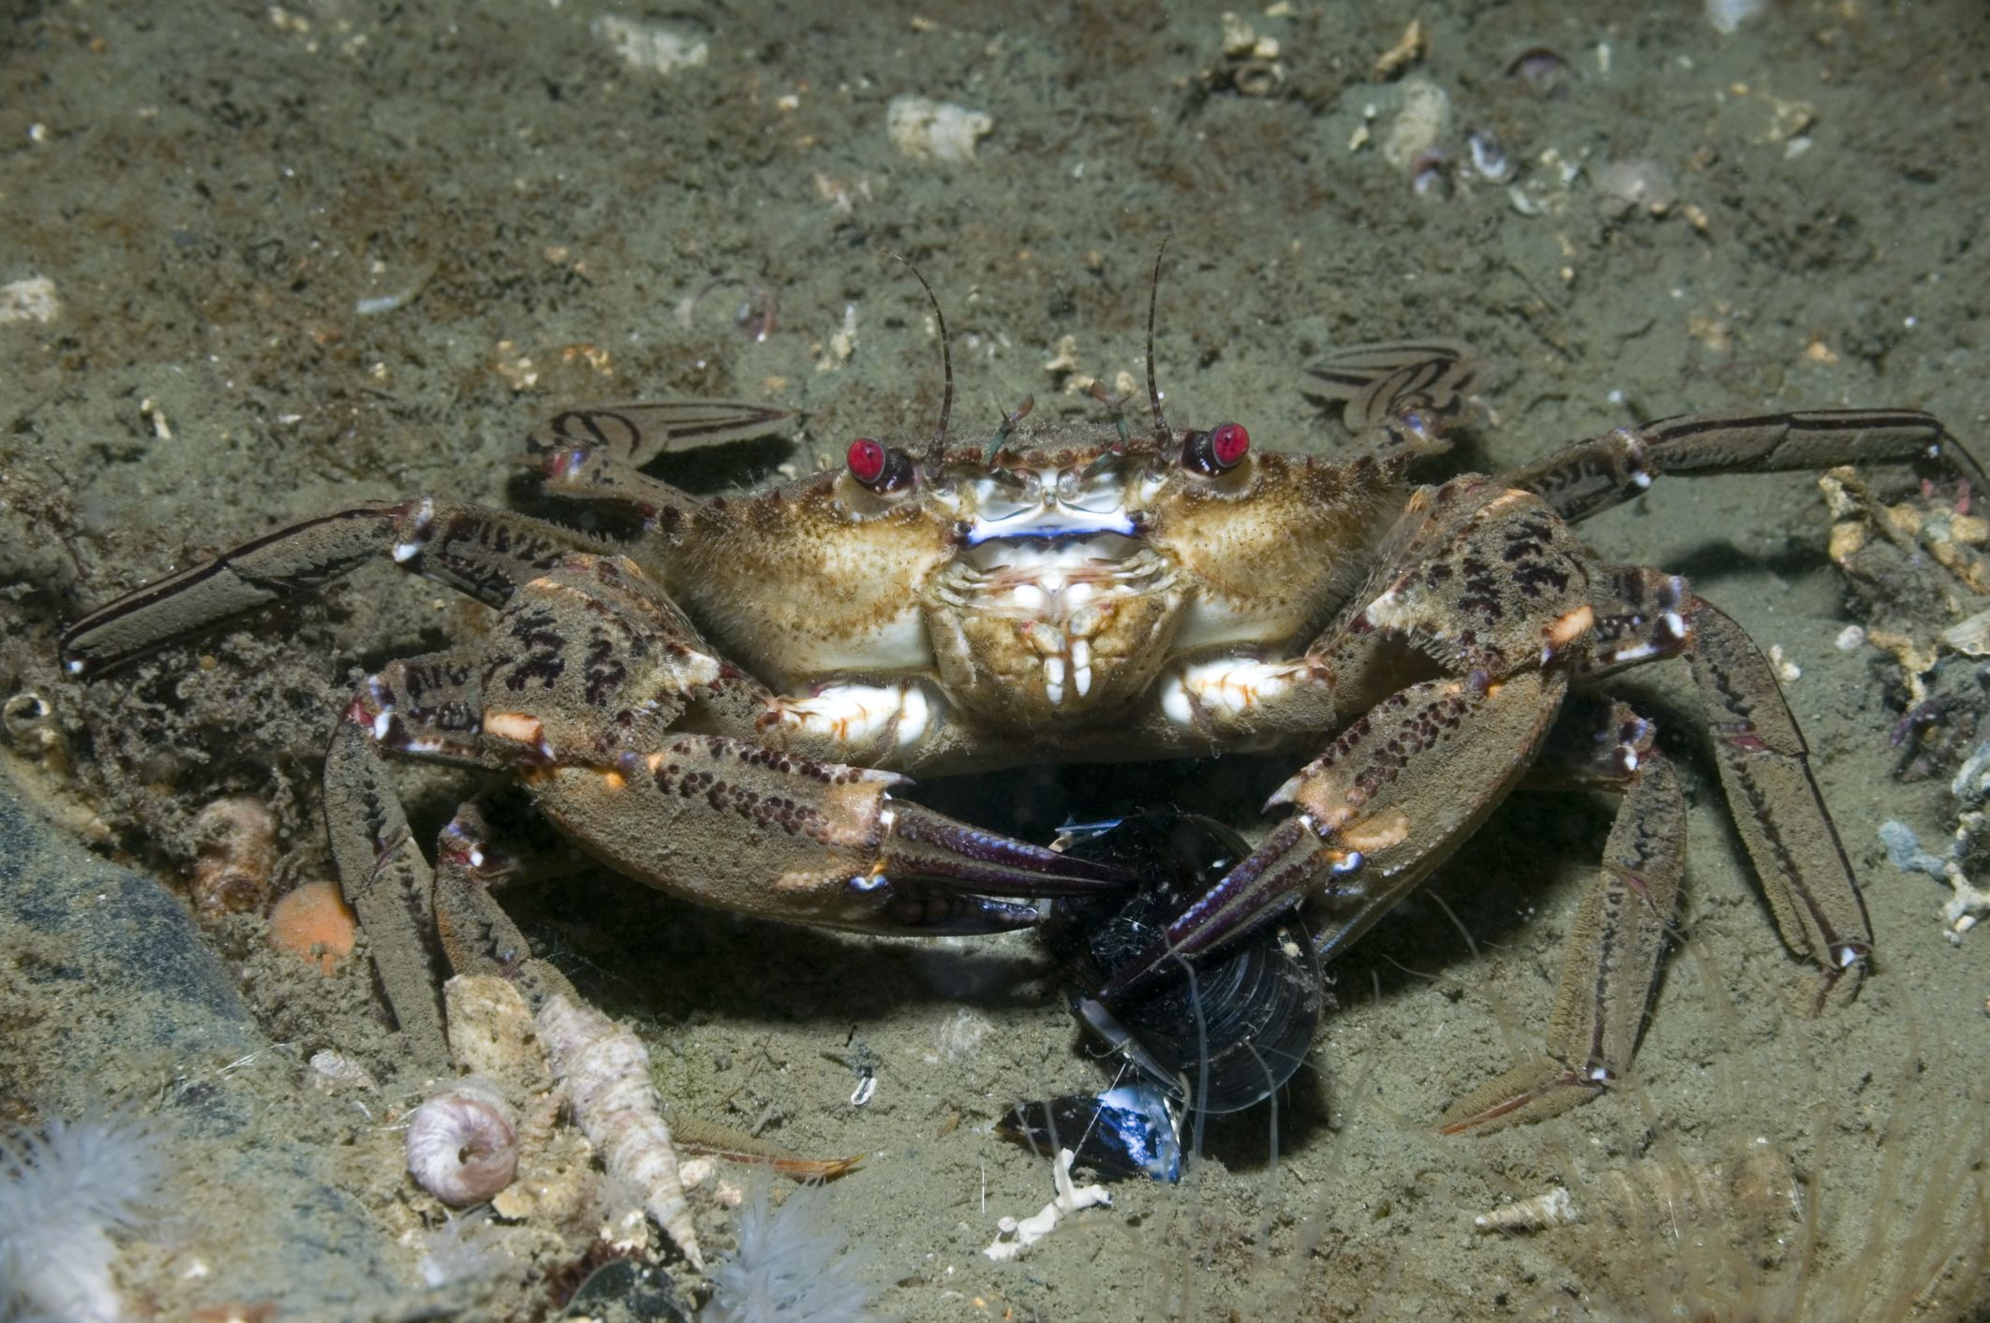
Feeding strategies
Marine arthropods are scavengers, so they eat basically anything that is on the sea floor
examples: algae, dead animals
Some arthropods are filter feeders

Slide 6
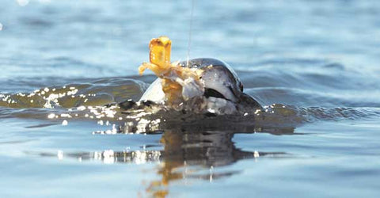
Predator/prey relationship
An example of a predator/prey relationship with arthropods could be crabs being eaten by redfish and black drum
Another example could be shrimp being eaten by snapper, sheepshead, trout, redfish, and black drum

Slide 7
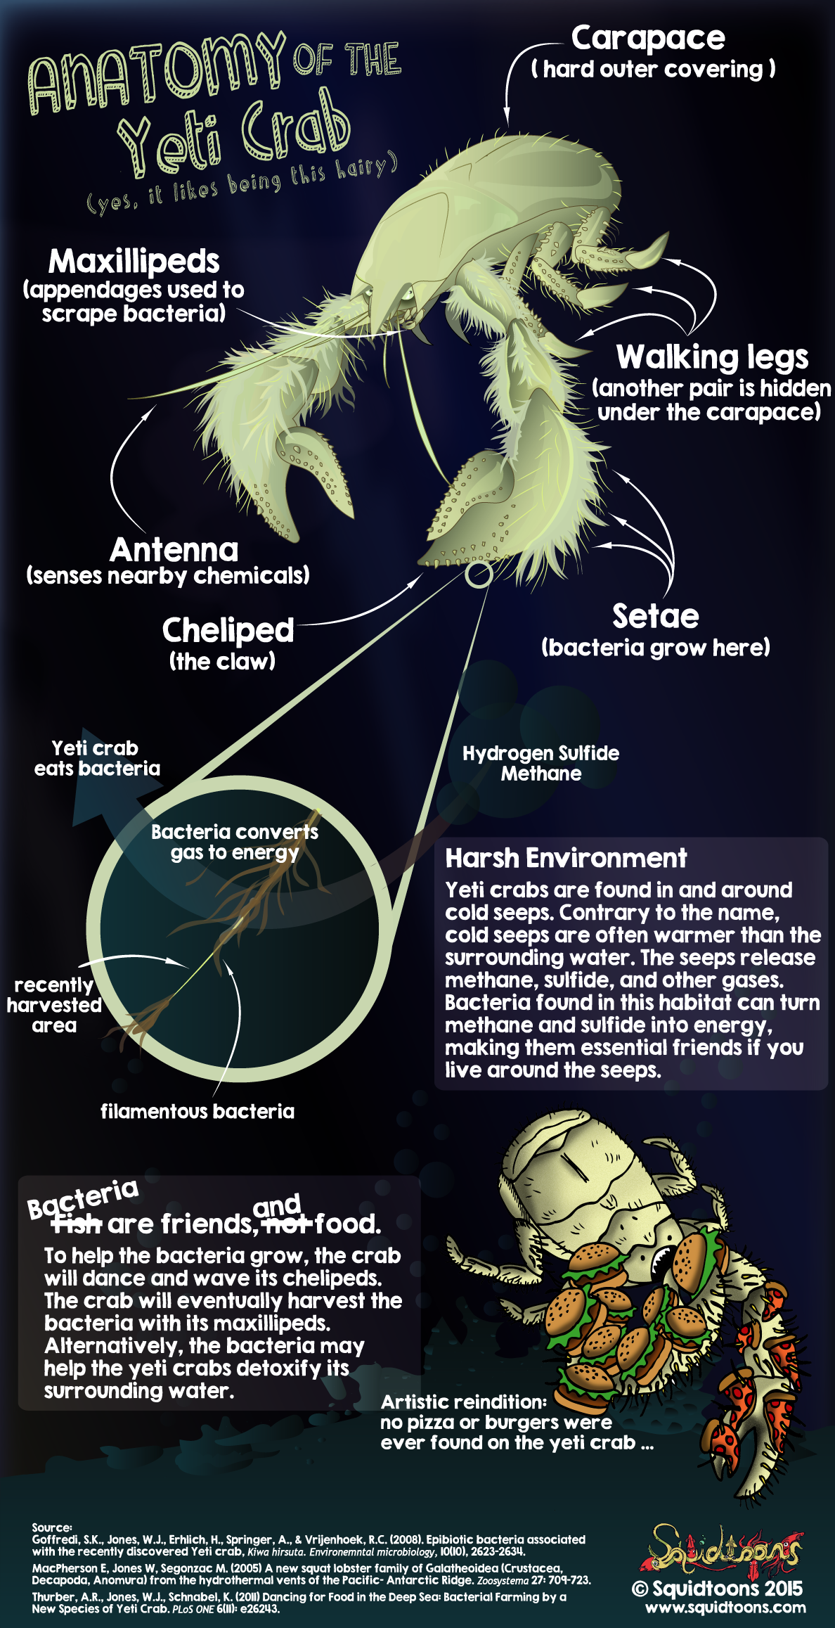
Symmetry/anatomy
Arthropods are bilaterally symmetrical, and their body possesses an external skeleton

Slide 8
Diagram

Slide 9
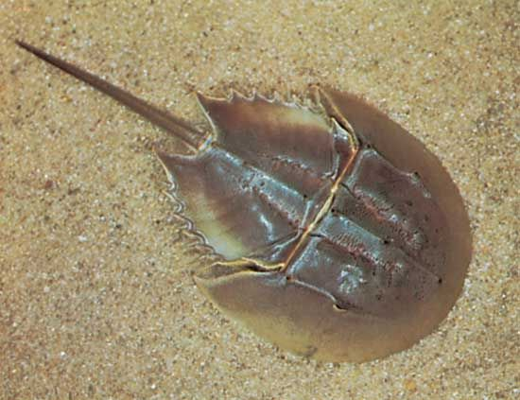
Adaptations
Arthropods are animals with jointed appendages and a chitinous exoskeleton. They are adapted to live in terrestrial environments. Some of these adaptations include reduced body size, presence of antenna and compound eyes, complete digestive system, and breathing through trachea, gills or book lungs

Slide 10
Animal 1

Slide 11
Animal 2

Slide 12
Animal 3

Slide 13
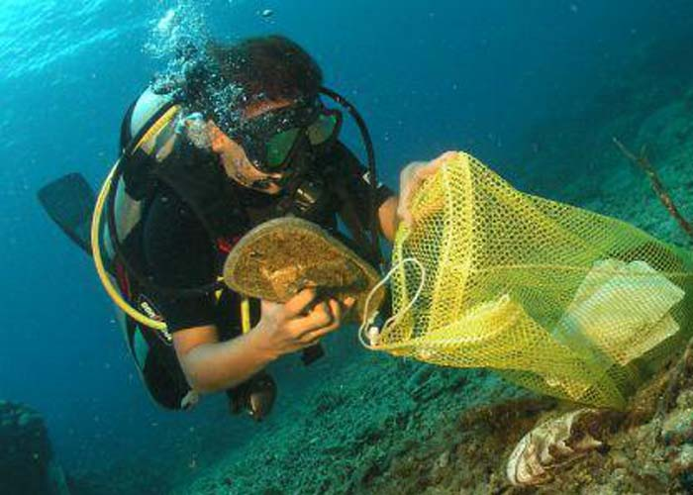
Negative/positive human impacts
Negative impact- a lot of people like to catch crabs and eat them but half the time they are overfishing and killing a lot of crabs in that specific habitat
Positive impact- People clean the algae and plastics that are in these animals habitat so they do not die

Slide 14
videos
https://www.youtube.com/watch?v=stUjTosyTPE
https://www.youtube.com/watch?v=r5sfZPXzSGE

Slide 15
Final analysis
Overall, me and Brody think that these animals are absolute beasts, and are cool animals to study because there is so much to learn about them

