Slide 1
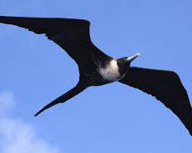
Marine coastal birds
By Nikolas Blood

Slide 2
Phylum introduction
they have dense waterproof feathers, layers of fat, and a desalinization system to remove excess salt.

Slide 3
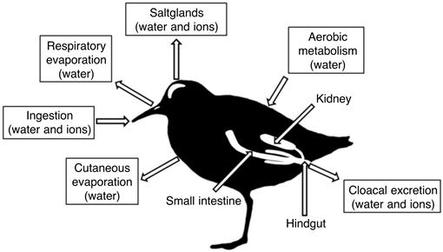
Some information
The habitat: salt marshes, rocky coastline, gravelly or sandy beaches, and offshore islands
The reproduction: the copulatory stage usually occurs after, and occasionally concurrently, with the formation of the pair bond.
There feeding strategies: dipping their head into the water to catch prey.
Predators and prey: feral cats and krill and forage fish
Anatomy of the birds shown in the picture

Slide 4
Diagram

Slide 5
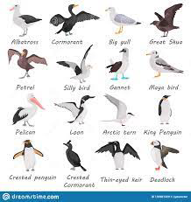
Adaptations to survive the environment
webbed feet.
highly waterproof plumage.
glands that get rid of excess salt.

Slide 6
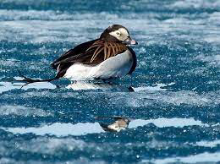
Three animals from the phylum
Brown pelican, gray-brown birds with yellow heads and white necks. There are 8 species of Pelicans but only the Brown Pelican lives primarily on coastal shores.
Pacific loon, fast fliers and can fly at 37 miles per hour. grey head and small size.
Horned grebe, a small grebe with a straight bill, thick neck, and squarish head. regularly eats some of its own feathers, and its stomach usually contains a matted plug of them.

Slide 7
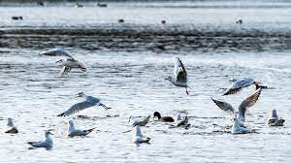
Human impacts
Conserve Water. Use less water so excess runoff and wastewater will not flow into the ocean.
Oil spills damage the sea so it hurts the animal’s

Slide 8
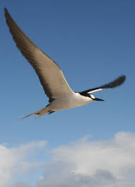
Final analysis
personally I think marine birds are cool and I would like to learn more about them.
Any questions ?

Slide 9
Two Video clips
https://youtu.be/zKzeMovBwL0
https://youtu.be/bk7McNUjWgw

Slide 10
Quiz
How fast does the pacific loon fly?
How many species of pelicans are there?
What are the 3 adaptations of marine birds?
What are the predators of marine animals?
What are the prey of marine animals?
What kind of habitat do they live in?
As stated in slide one what kind of feathers do they have?
What is the top of marine bird heads called?
desalinization system meaning?
Do marine birds have layers of fat?

