Slide 1
Marine Reptiles (Chordata Reptilia)
By Shianne and Asher

Slide 2
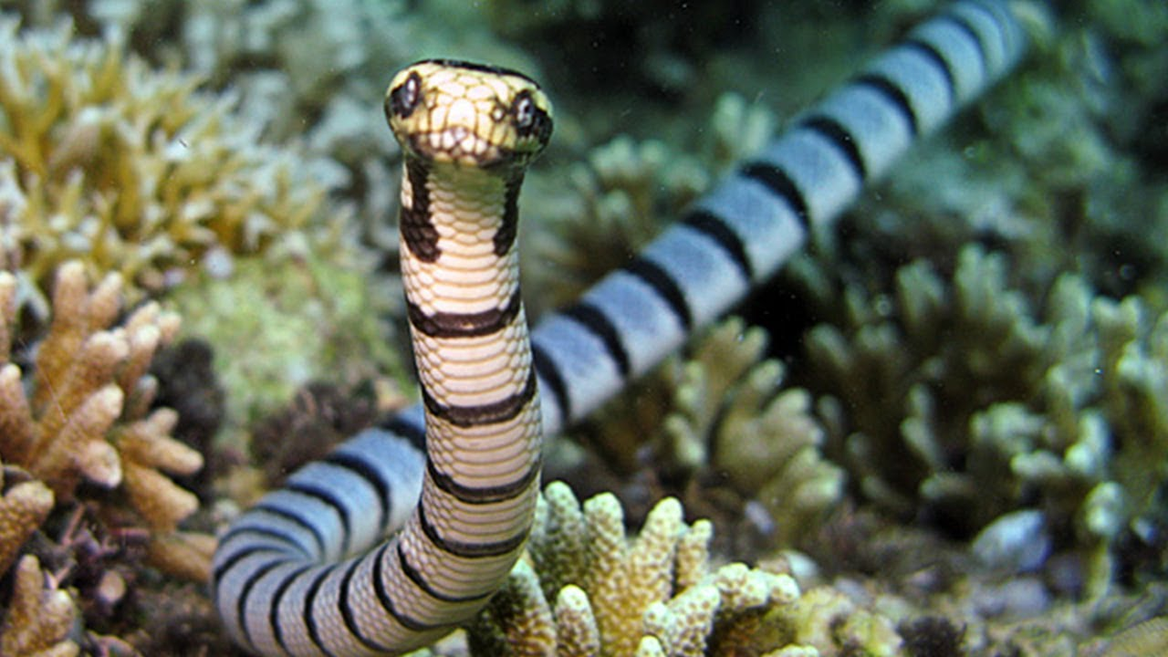
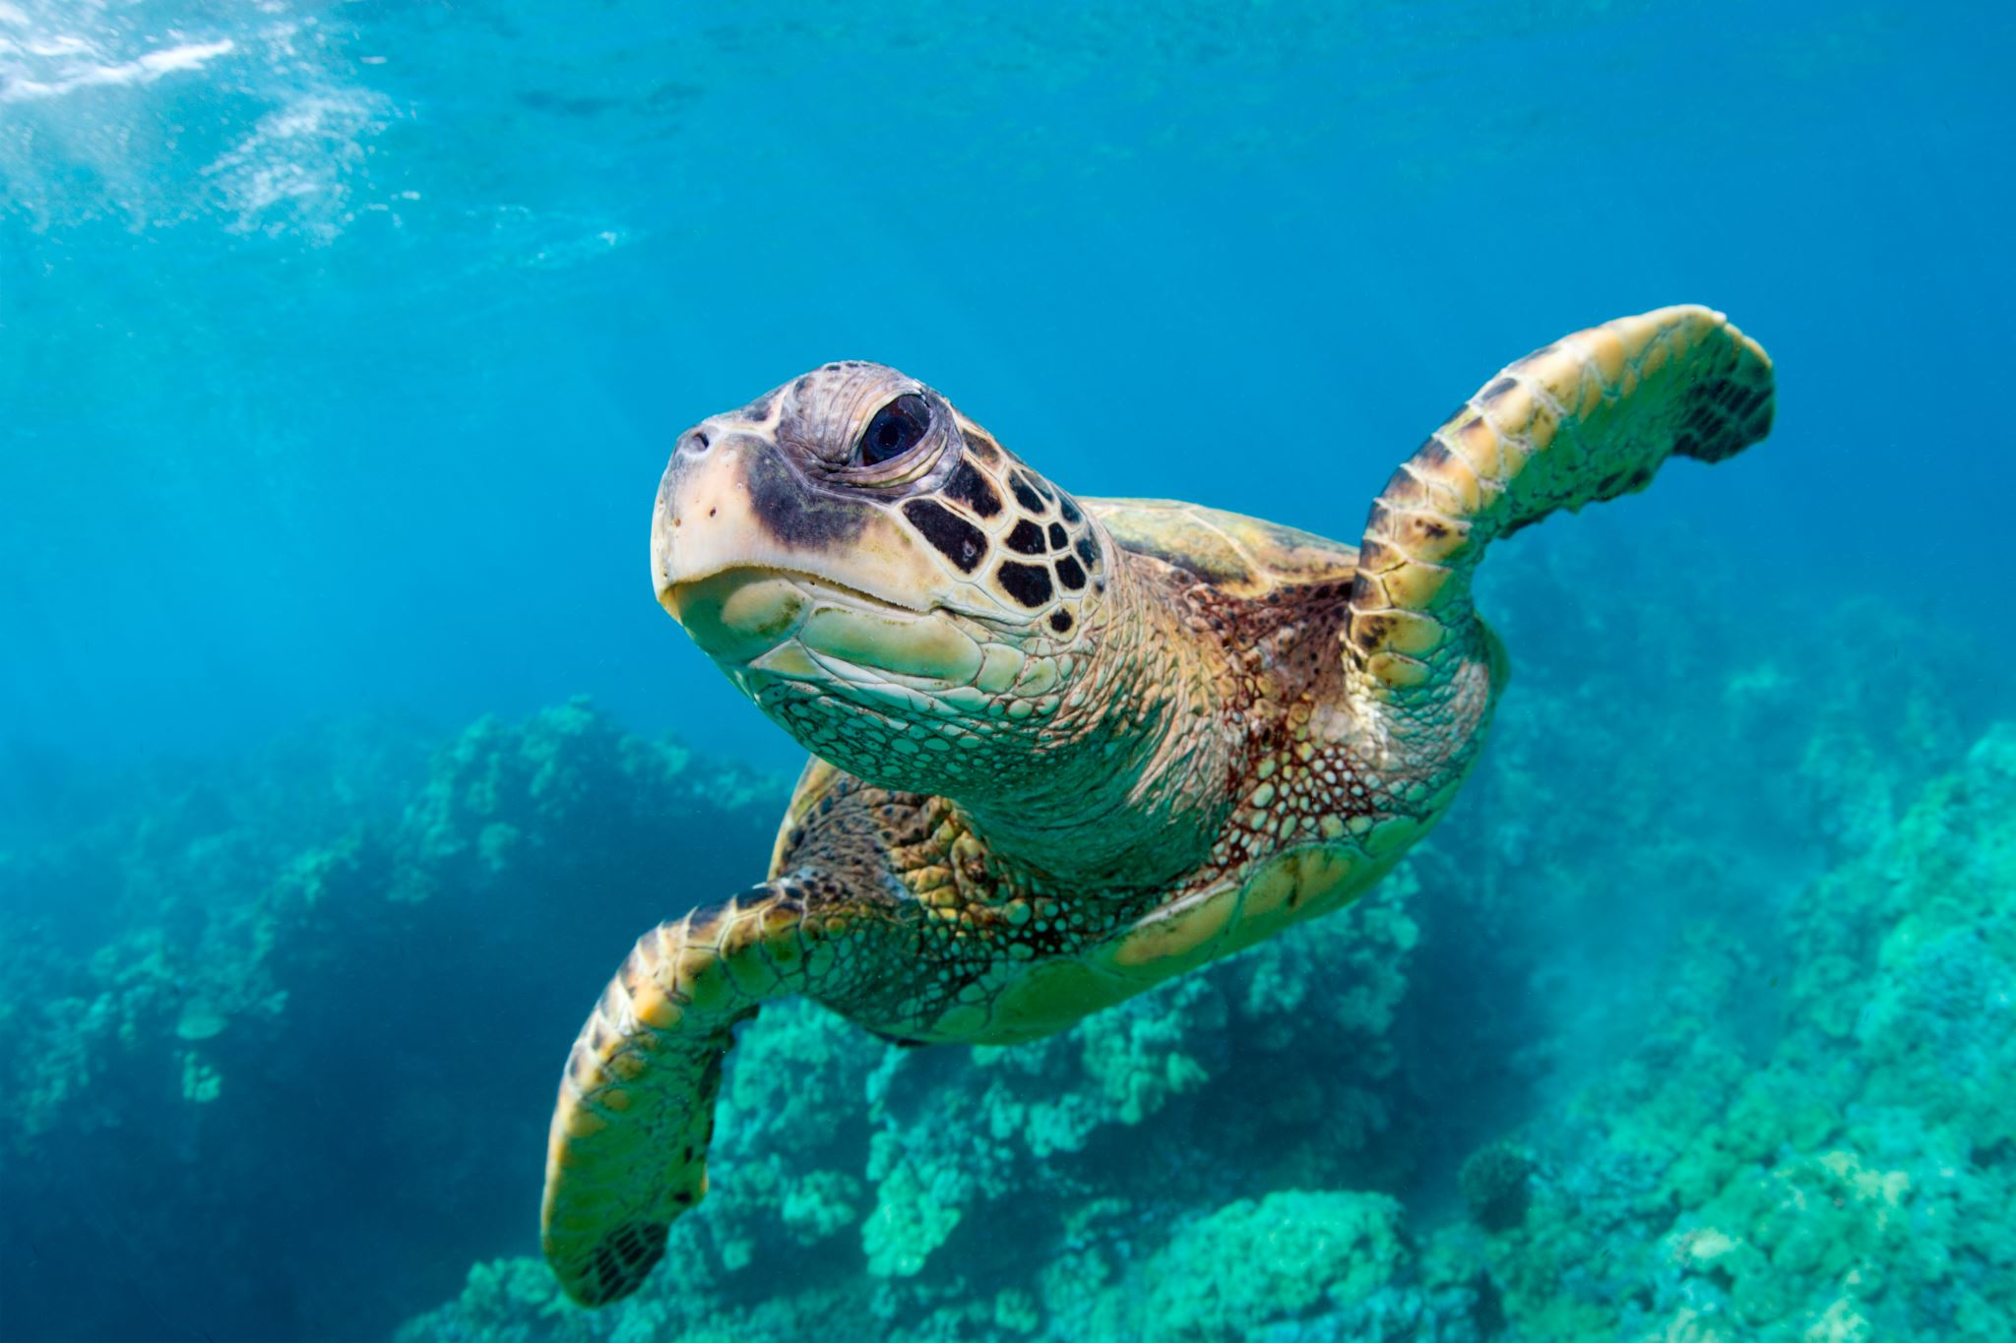
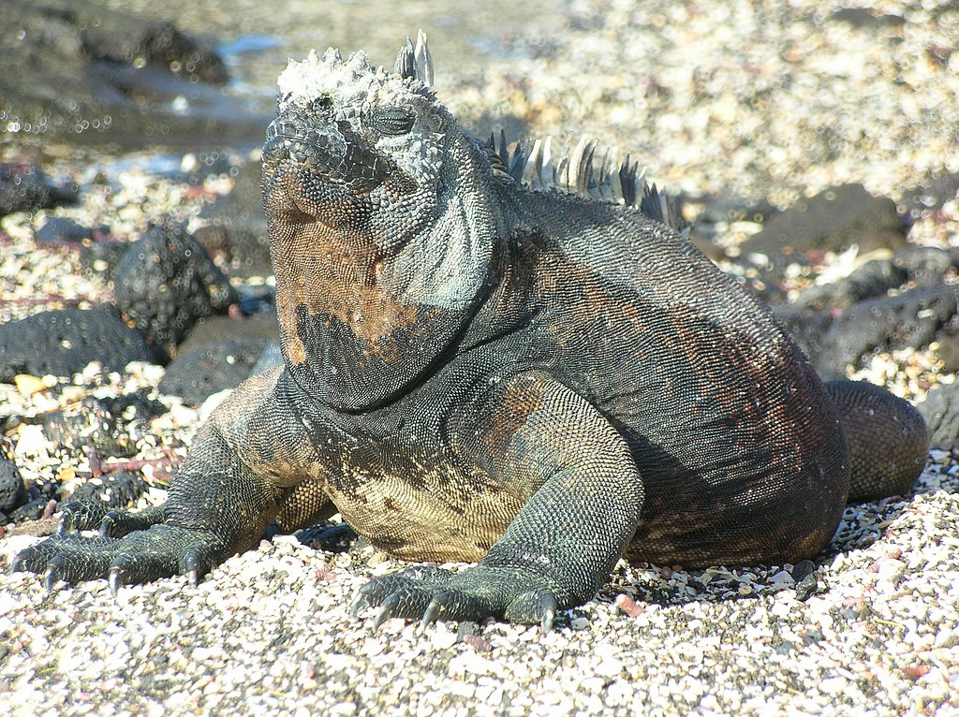
Invertebrate
2
Sea Snakes
1
3
Sea Turtles
Marine Reptiles
You can describe the topic of the section here
You can describe the topic of the section here
You can describe the topic of the section here

Slide 3
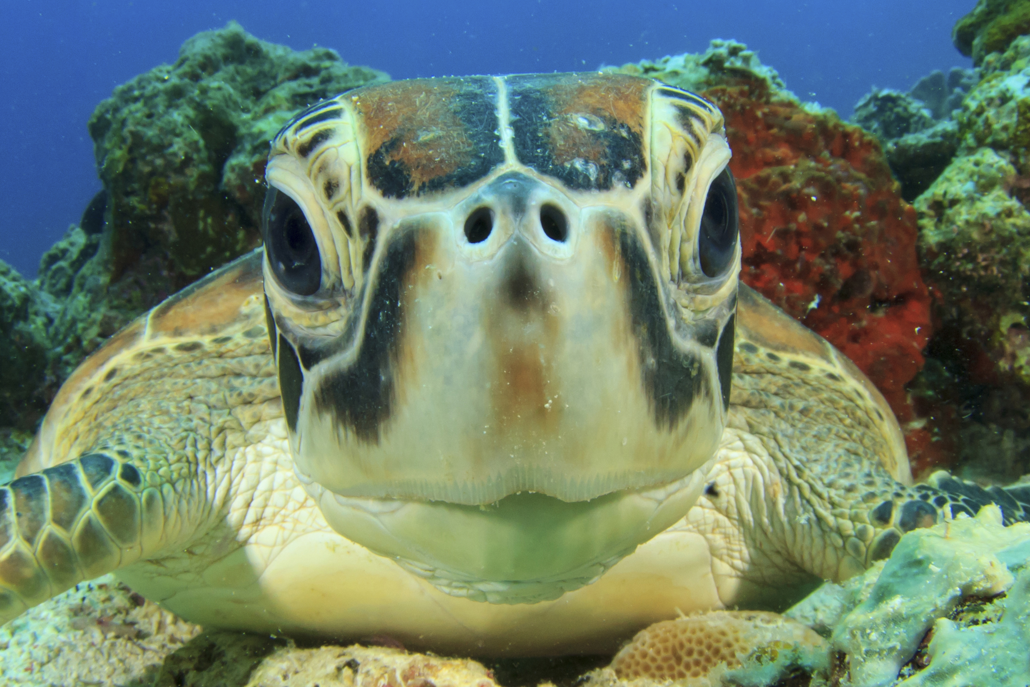
Characteristics
scaled bodies (or scrutes in which turtles have)
-cold blooded
- bear live young
- eggs
-fertilize eggs internally
-have at least one lung
-three chamber heart
-ectothermic

Slide 4
Way of Life
Habitat
Reproduction
Feeding
Coastal areas around the world
- shelled eggs that are fertilized internally and layed
-Live young (although more commonly in the past than today)
-Some return to shore to lay eggs.
- Sea snakes eat fish, eels, crustaceans, and in some cases, fish eggs and small octopuses towards the bottom of the coral reef.
-Sea turtles and the marine iguana are herbivores and feed on sea grasses, algae, and seaweed.

Slide 5
Predator and Prey
Predator
Prey
Sharks prey on sea turtles (Ex. tiger shark preys on leatherback sea turtles)
Sea snakes prey on small fish coral reefs. (all sea snakes have a potent venom)

Slide 6
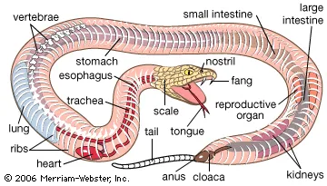
Symmetry/anatomy
Bilaterally symmetrical

Slide 7
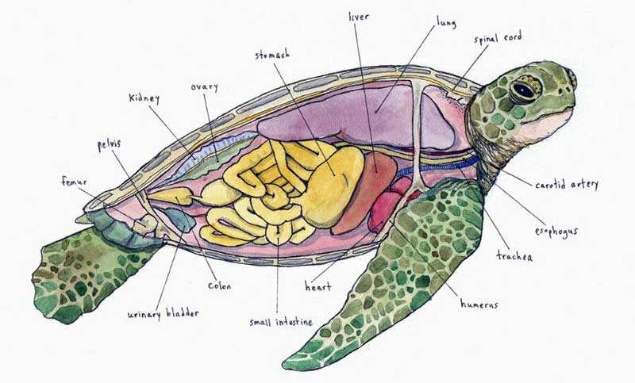
Diagram
Sea turtle

Slide 8
Video
https://www.youtube.com/watch?v=UDAutlF_aRY

Slide 9
Adaptations
The marine iguana has sharp, razor like teeth for tearing algae off rocks (since algae is their primary food source). They also have incredibly sharp nails to cling to the rocks in the Galapagos islands in which they reside.
-Leatherback turtles are able to maintain a warmer body heat than the majority of other reptiles. This adaptation includes their larger body size, changes in swim activity, blood flow, and having a thicker layer of fat.
- Sea snakes have flattened, oar-like tails that help them move through the water at a faster pace. They also have salt glands in their nostrils that help them breathe more efficiently.

Slide 10
Leatherback Sea Turtle Dermocheyls Coreacia
Leatherback Turtles are the largest of all sea Turtles and can grow to be 8 or more feet and can weight up to 2,000 pounds
A primary food source for them would be jellyfish.
They are tropical nesters and return to costal areas such as mexico and costa rica to lay their eggs.
Average lifespan is 45-50 years
They reach maturity inbetween 9-20 years

Slide 11
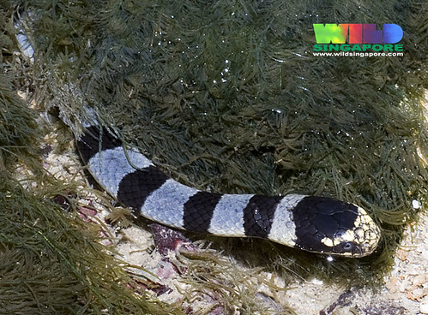
Yellow-lipped Sea Krait (Laticauda Colubrina)
Semiaquatic. They hunt in the ocean and return to land to digest, rest, and reproduce.
Carnivores. Eat small fish and eels.
During mating season (september-december), The female sea kraits have many partners. This sort of mating system is called polyandry. They lay clutches of eggs which develop outside of the body.
https://animalia.bio/yellow-lipped-sea-krait
This Photo by Unknown Author is licensed under CC BY-NC-ND

Slide 12
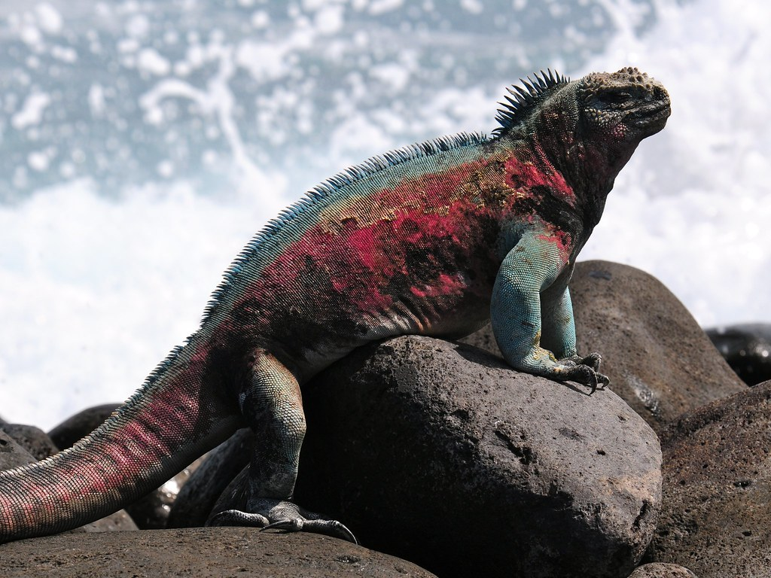
Marine Iguana (Ambyrhynchus Cristatus)
They live exclusively in the galapagos Islands
Average lifespan is 5-12 years
They are herbivores and eat algae and seaweed
Non native predators (rats, cats, dogs) feed on their eggs.
They have long claws for clinging onto the rocks of the shore
They have specific glands in which cleans their blood of excess salt from the water
https://www.nationalgeographic.com/animals/reptiles/facts/marine-iguana
This Photo by Unknown Author is licensed under CC BY

Slide 13
Human impacts
Sea turtles are poached for their meat, shells, eggs, and skin
bycatch and overfishing
Costal development causes habitat loss
pollution

Slide 14
Thank you!
Videos
﻿​﻿​​Sea Kraits (Snakes) New Caledonia – YouTube
https://www.youtube.com/watch?v=aRYDw3CdqBU

