Slide 1
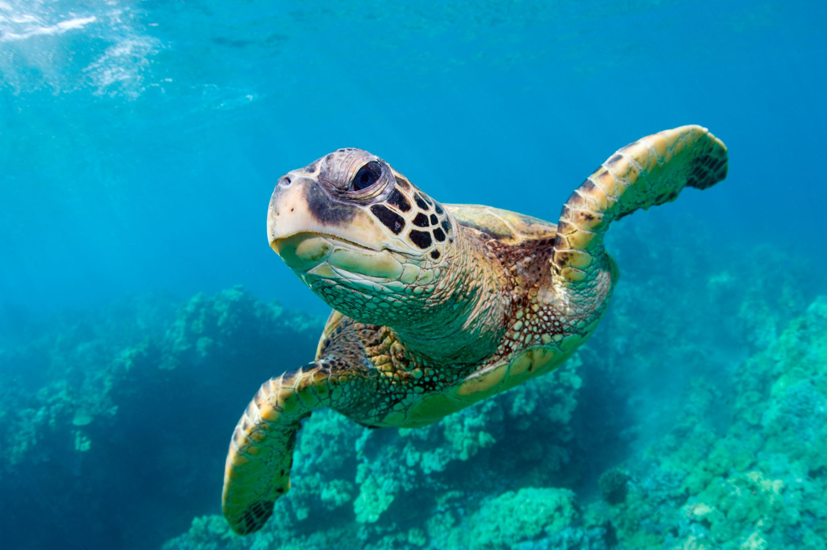
MARINE REPTILES
May, 4
2022
Maddy Hunt and Sydnee Glugover

Slide 2
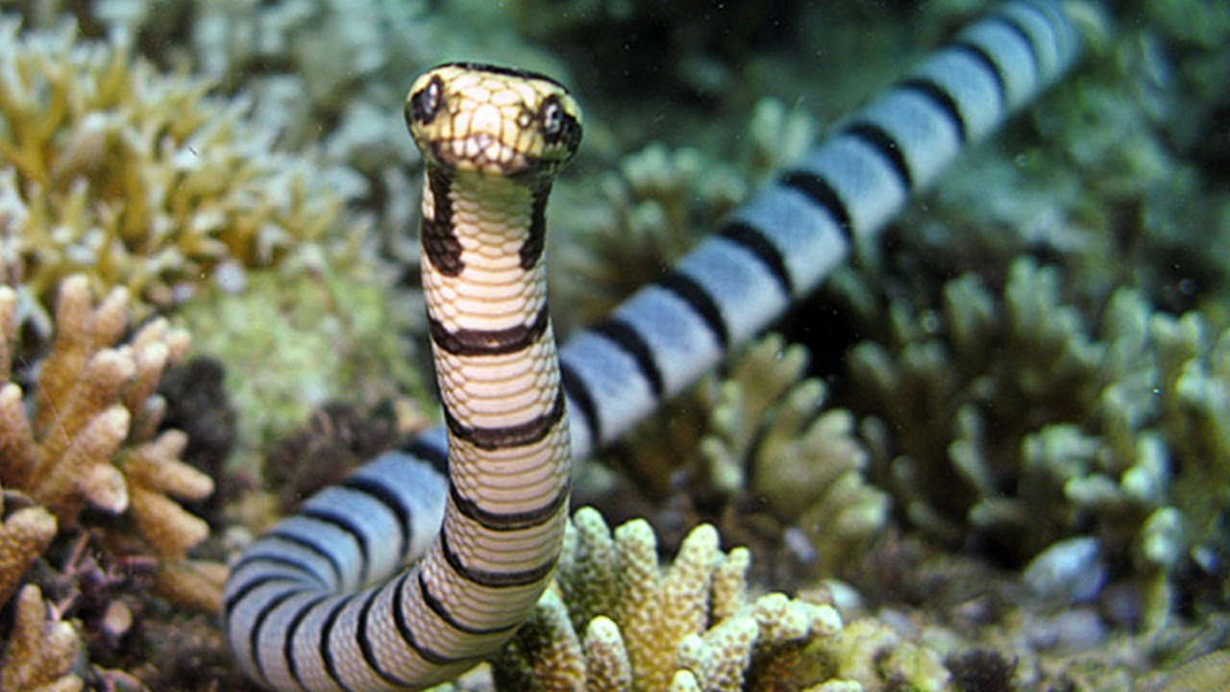
ABOUT THIS PHYLUM
Animals
Sea Turtles
Sea Snakes
Marine Iguanas
Characteristics
Ectothermic (depends on external sources for body heat)
Scales (keratin)
Respire with lungs

Slide 3
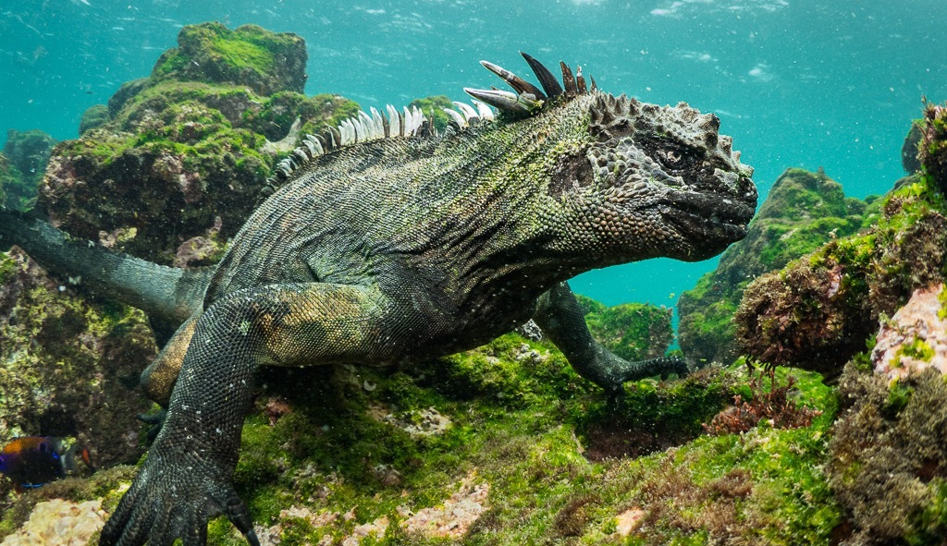
HABITAT
Tropical and sub-tropical waters
Off Indian and Pacific Ocean
What are the living conditions for most marine reptiles?

Slide 4
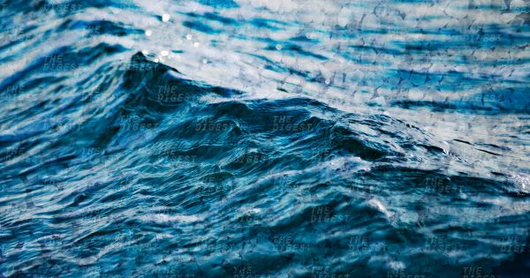
REPRODUCTION
How to they reproduce?
Mostly sexual reproduction
Internal fertilization
Men have sperm which transfers to the cloaca where the fertilization happens
This Photo by Unknown Author is licensed under CC BY-NC

Slide 5
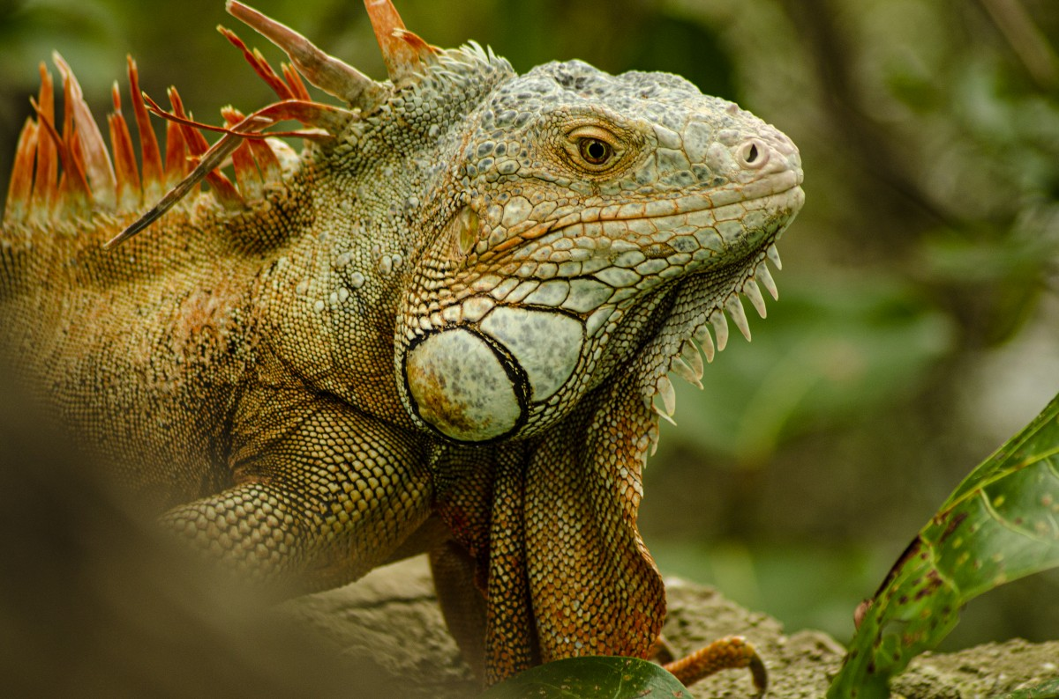
FEEDING STRATEGIES
Diet includes
Fish
Cephalopods
Other vertebrates
Hard-shelled invertebrates
What do they eat?

Slide 6
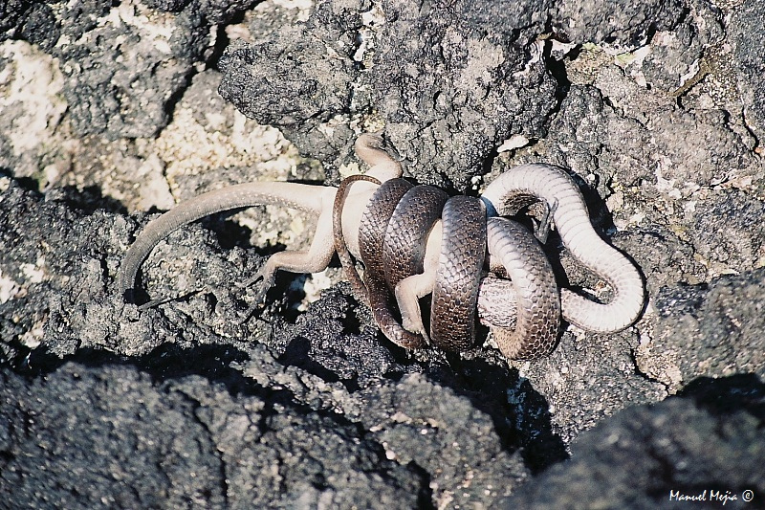
PREDATOR/PREY RELATIONSHIPS
Predator | Prey
Snakes And many other reptiles and species. | The food previously stated on the slide before.
How do they eat?
This Photo by Unknown Author is licensed under CC BY-NC-ND

Slide 7
SYMMETRY/ANATOMY
most of the characteristics describe the similarity's between all marine reptiles.

Slide 8
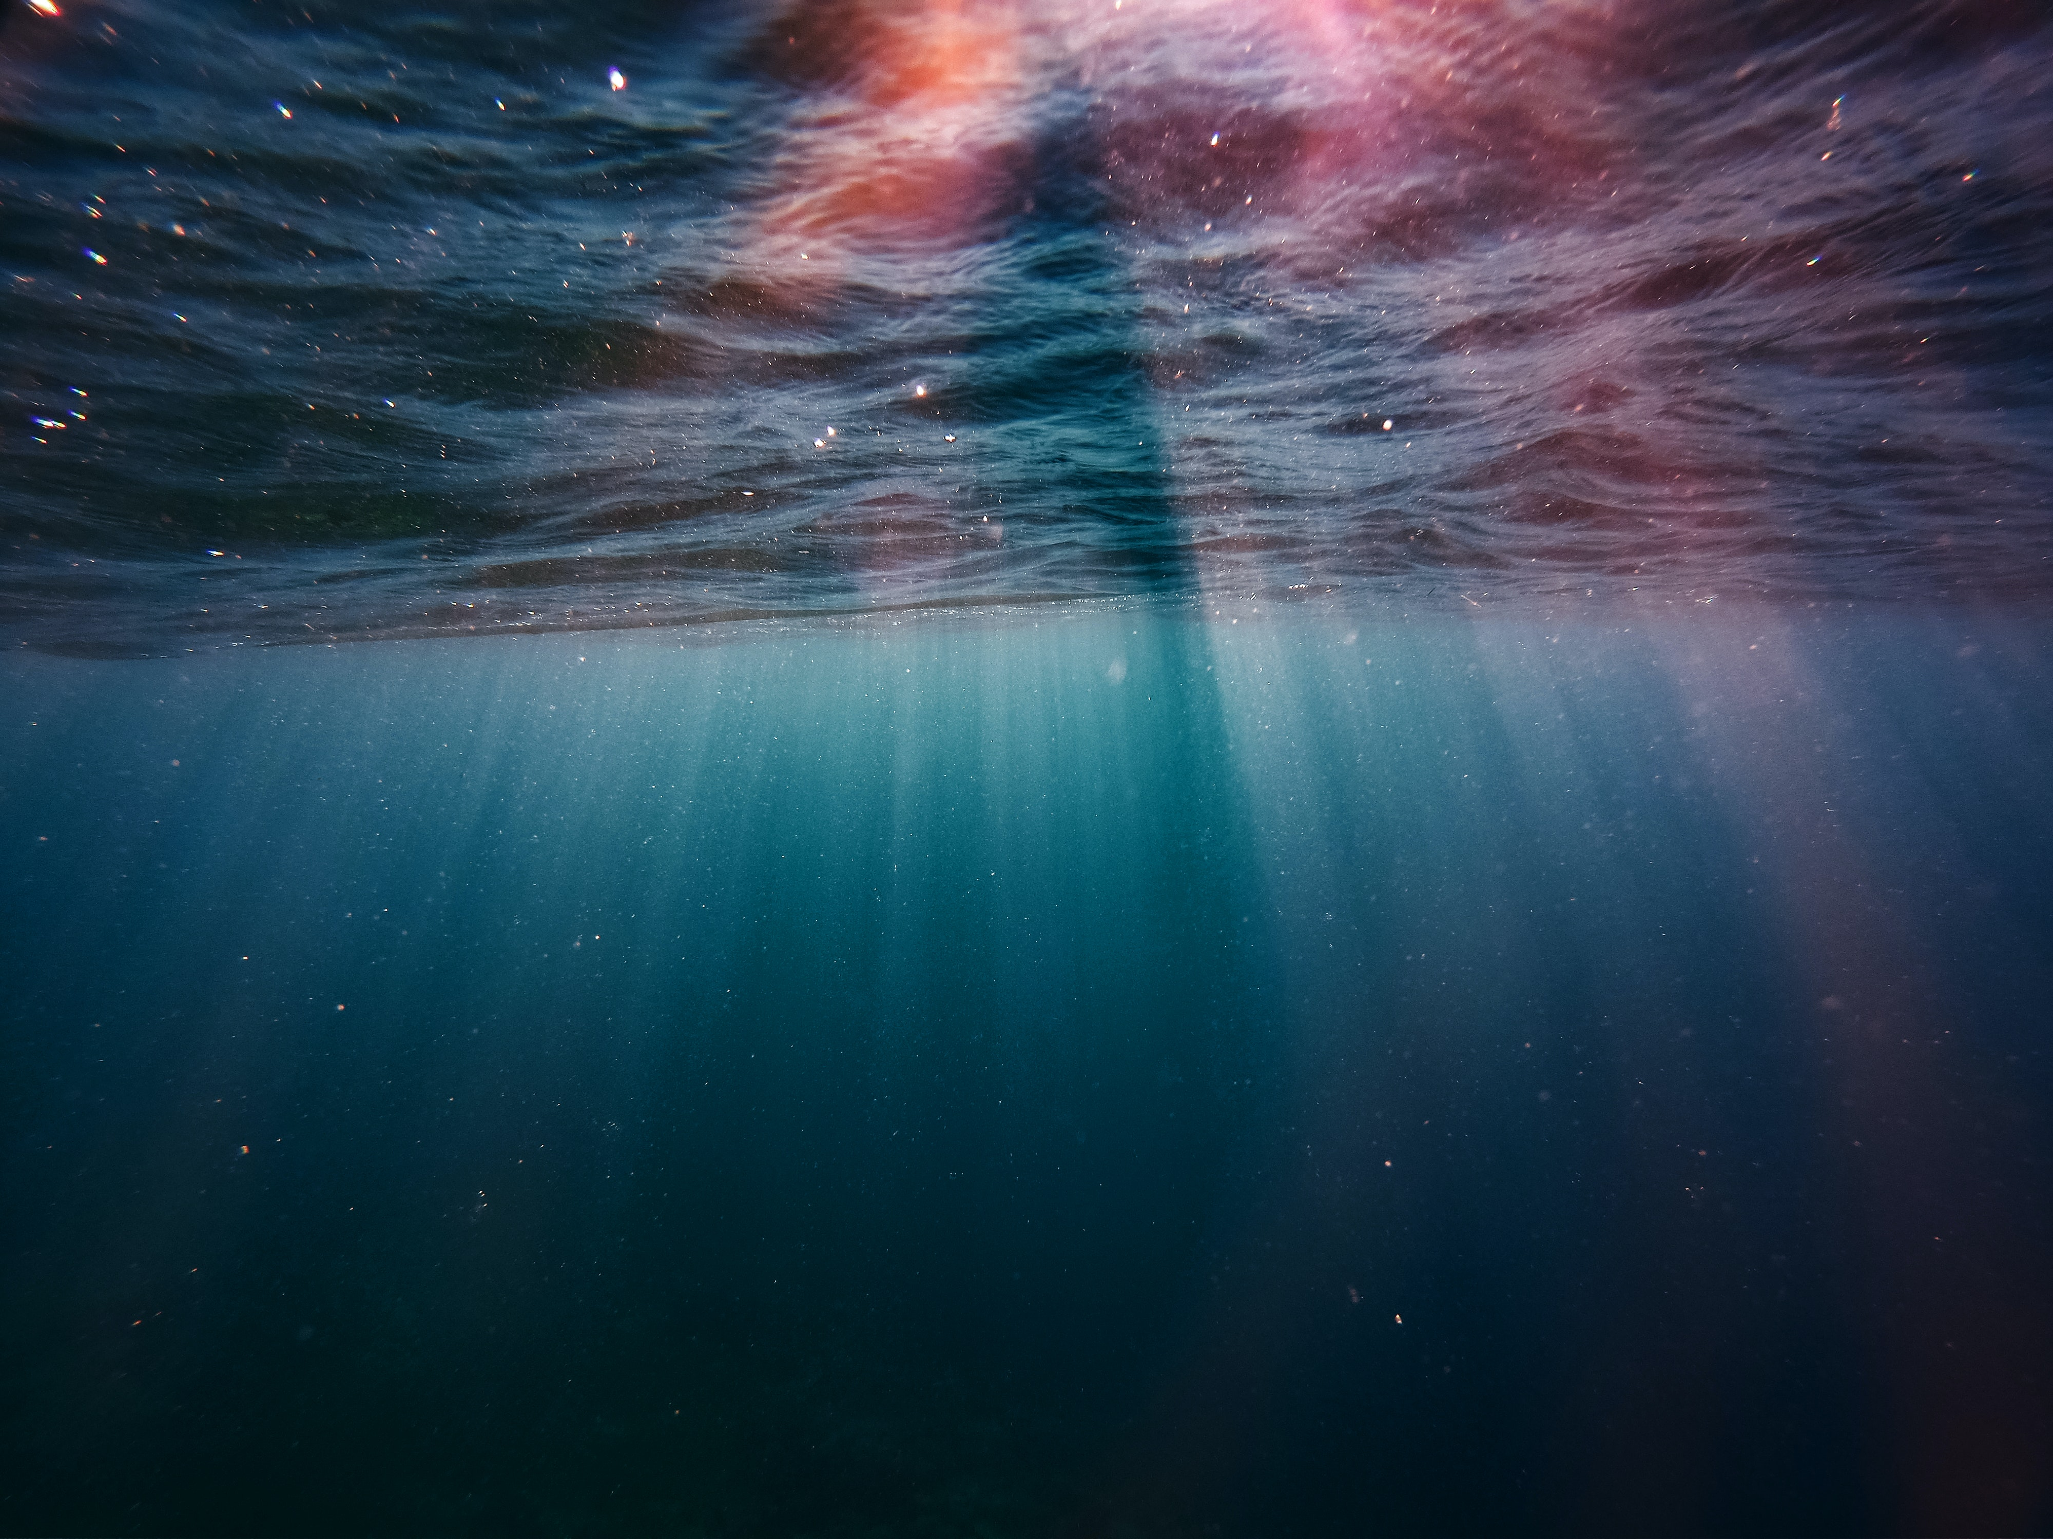
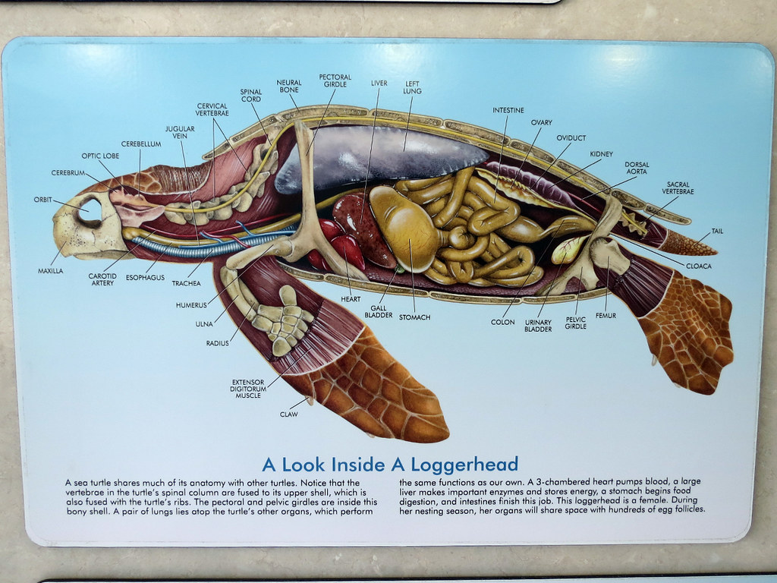
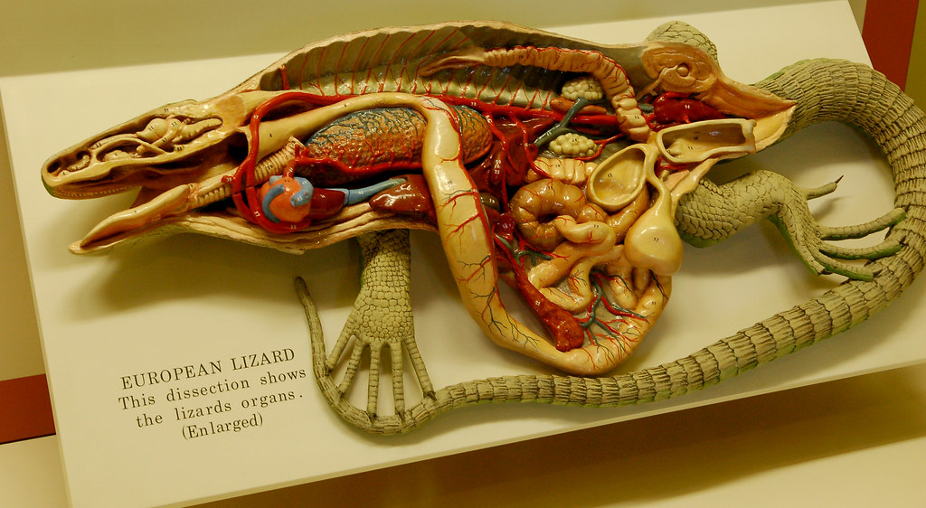
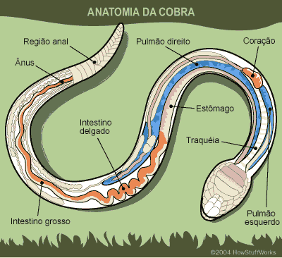

Slide 9
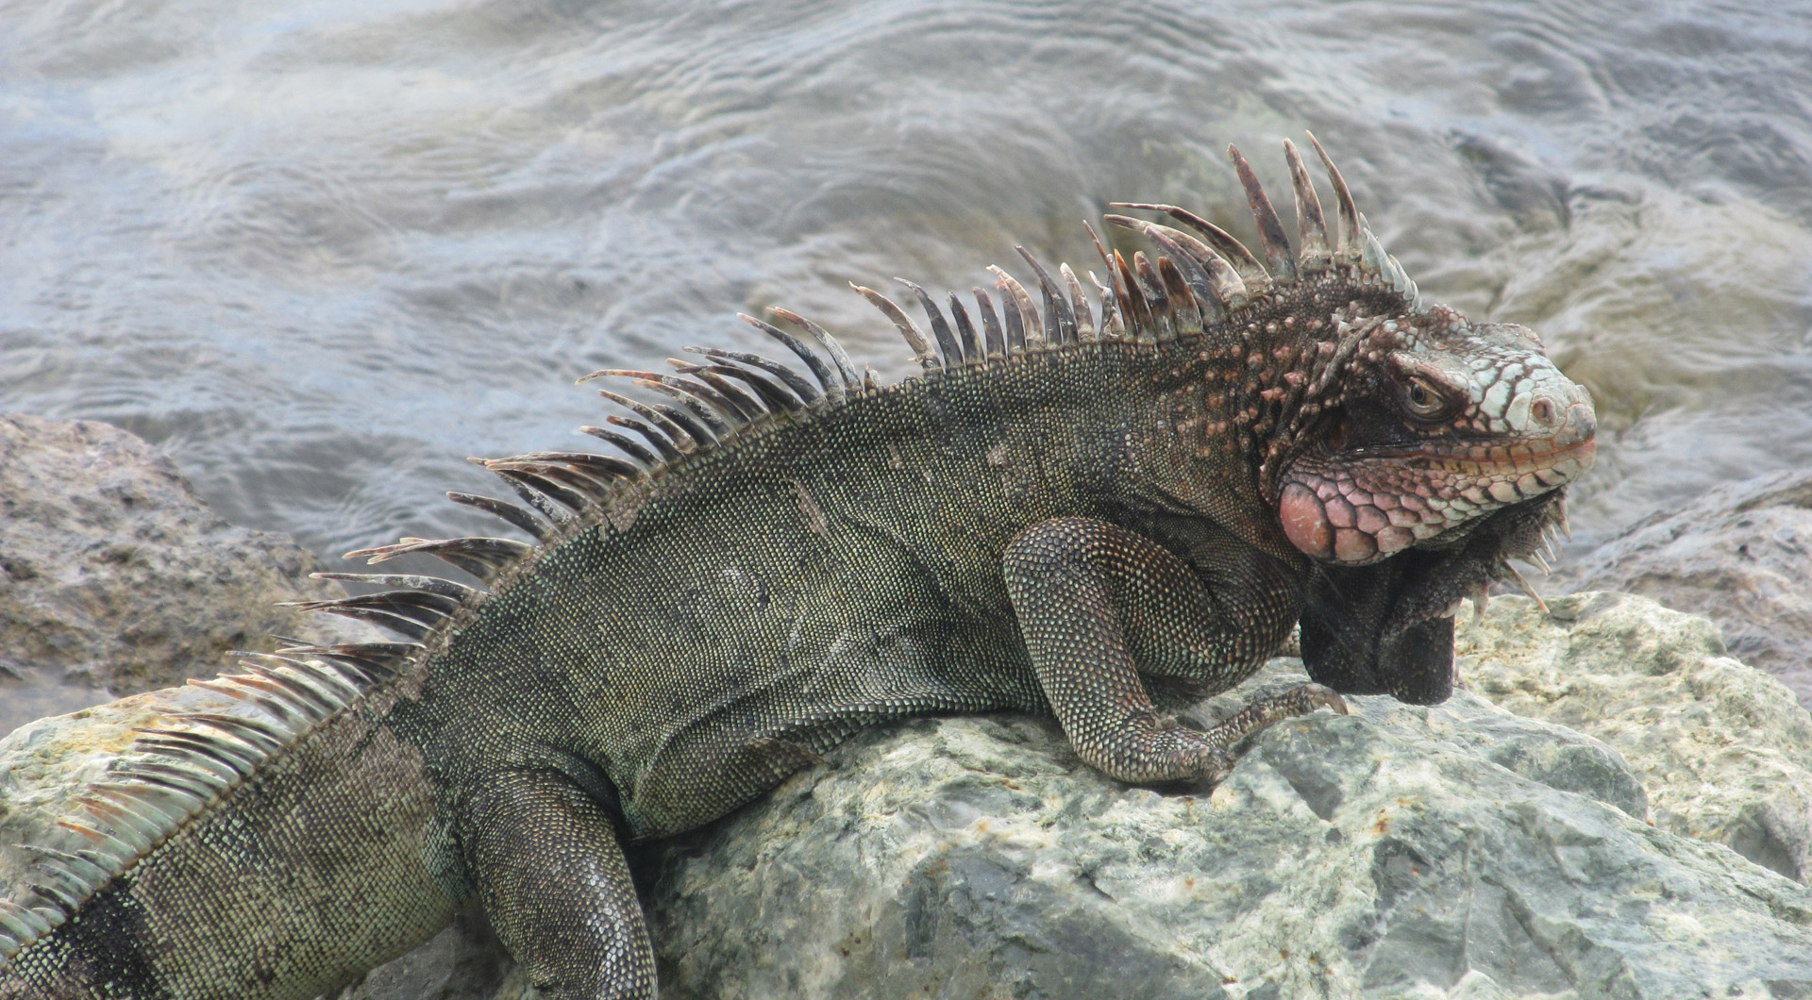
Adaptations
Adaptation 1 | They have had to adapt to saltier environments. | Solution: salt glands, to excrete salt from their systems.
Adaptation 2 | They have had to adapt to being underwater for long times. | Solution: have adapted by having a deeper lung capacity.
Adaptation 3 | The water is a higher density and viscosity than on land. | Solution: They have had to adapt to the pressure, density, and viscosity of the water.
The adaptations that most marine reptiles have in common that they have changed to survive.

Slide 10
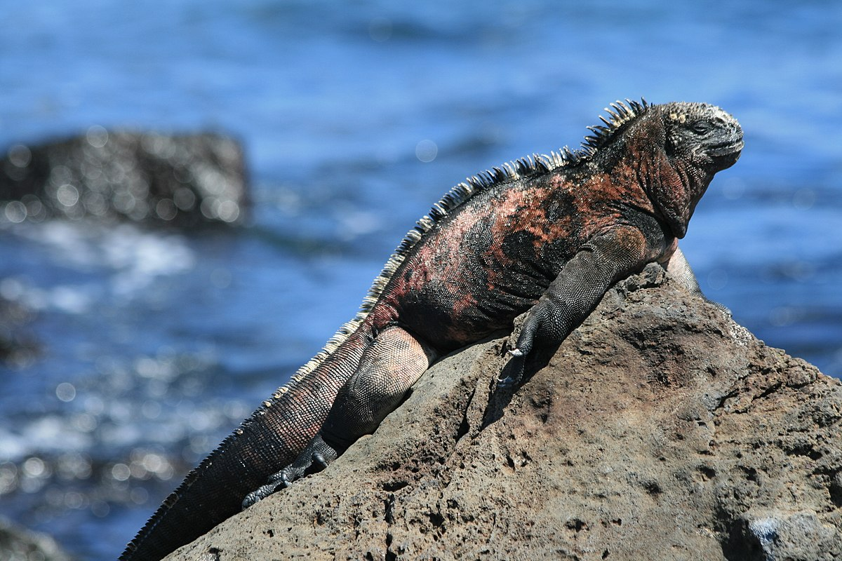
Marine Iguana
Habitat - They live in the Galapagos
Food - They eat seaweed
Reproduction - They lay eggs and sexually reproduce
This Photo by Unknown Author is licensed under CC BY-SA

Slide 11
Sea Turtles
Habitat - Shallow warm coastal waters
Reproduction - They lay eggs and live up to about 15-30 years old
Food - Invertebrates such as jelly fish and seaweed

Slide 12
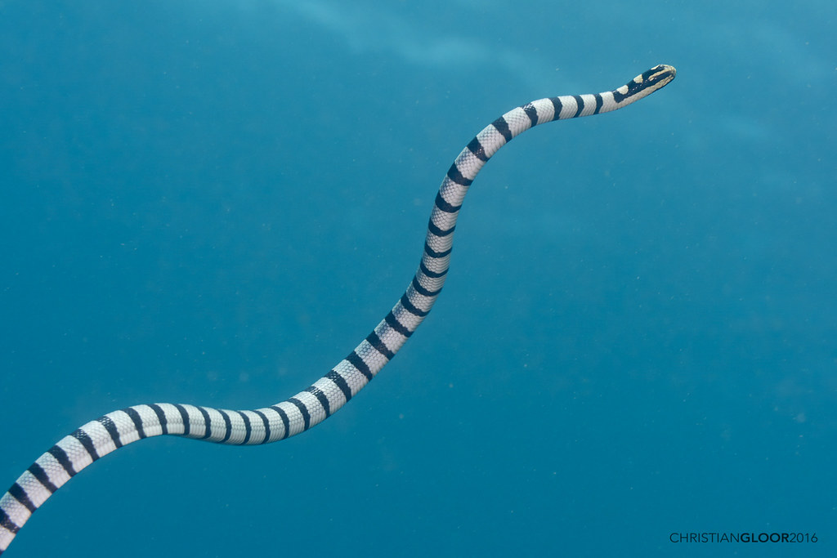
Sea Snakes
Over 50 species
Habitat - Tropical climate, Indo -pacific and Eastern-pacific
Anatomy – 3-9ft, colored bands, highly venomous
Reproduction - They are Oviparous (females keep eggs in them and give live birth)
Food - fish
This Photo by Unknown Author is licensed under CC BY

Slide 13
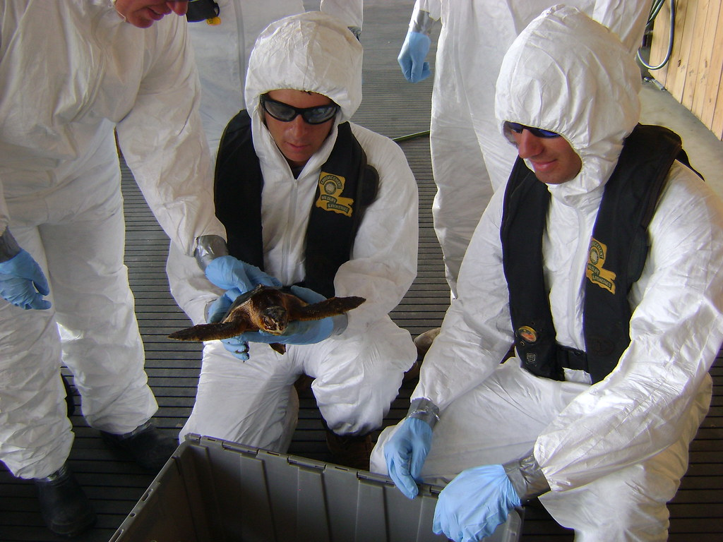
HUMAN IMPACTS
What are the impacts of humans on marine reptiles?
Positive
Negative
There are some pretty simplistic things that humans do to positively effect marine reptiles.
Fixing our mistakes: Helping clean our oceans and using more eco-friendly, biodegradable things and supporting our businesses that help to clean the waters.
We have specialists who can help care for the needs of a specific marine reptiles as well as preserving populations.
Climate change/global warming is causing two major problems mainly to marine reptiles. Number one being the warming of the water and changing weather patterns as well as migration patterns in several species.
Warming also threatens marine reptiles by increasing salinity because of melting ice putting more salt into the water.
Pollution creates a HUGE problem. (including: micro plastics, waste, non- biodegradable substances, and many other things.)
This Photo by Unknown Author is licensed under CC BY-SA

Slide 14
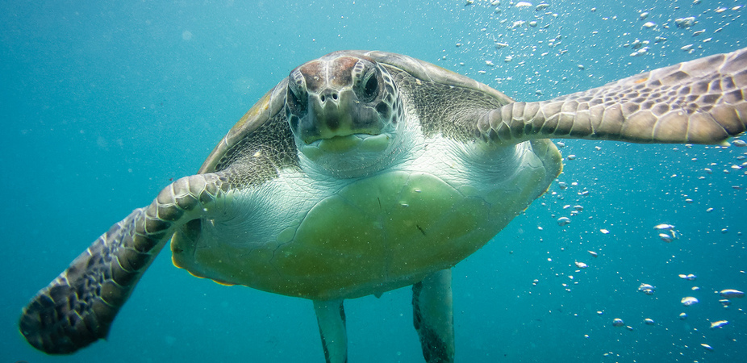
VIDEO SLIDE
https://youtu.be/aRYDw3CdqBU
This Photo by Unknown Author is licensed under CC BY-ND

Slide 15
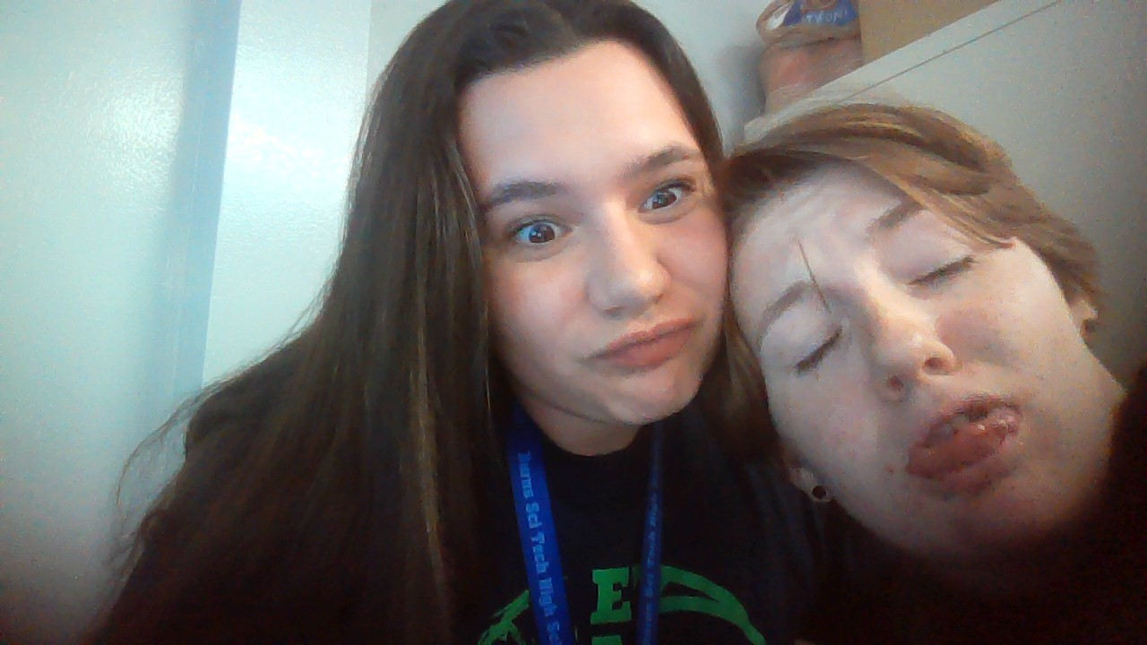
THANK YOU!
Kahoot Quiz:
https://create.kahoot.it/share/marine-reptiles/9099023f-104e-4433-a4dc-9a179d8e5fdc
Closing comments
none
By
Sydnee Glugover and Maddy Hunt

