Slide 1
Osteichthyes

Slide 2
CONTENTS
Introduction
Animals
Final Analysis
Activities
Phylum intro and phylum information
Some adaptations, learn about a few animals, along with some diagrams and more!
The overall of this project
Quiz link and activity information

Slide 3
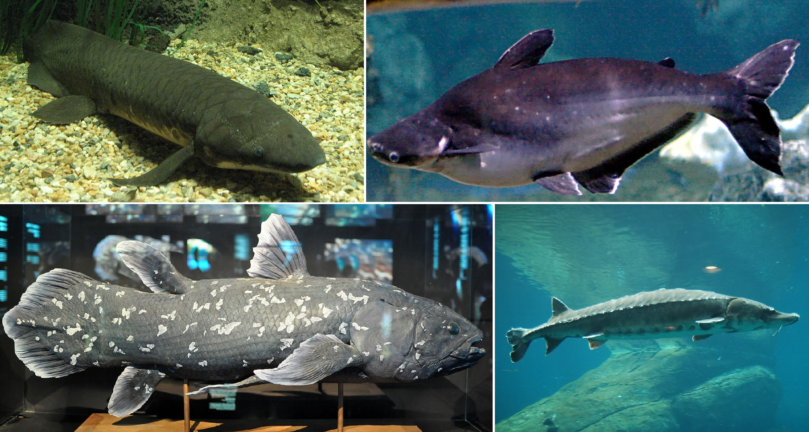
Phylum Information
Phylum- Chordata
Class- Osteichthyes
A class of jawed fishes having a bony endoskeleton
Largest class of vertebrates and includes a diverse group of marine bony fishes (96% of the Earth's fish come from this classification)
Ray-Finned Fish
Thin flexible skeletal rays
Lobed Finned Fish
Muscular fins
Characteristics
Skeleton more or less bony
Some with and without scales

Slide 4
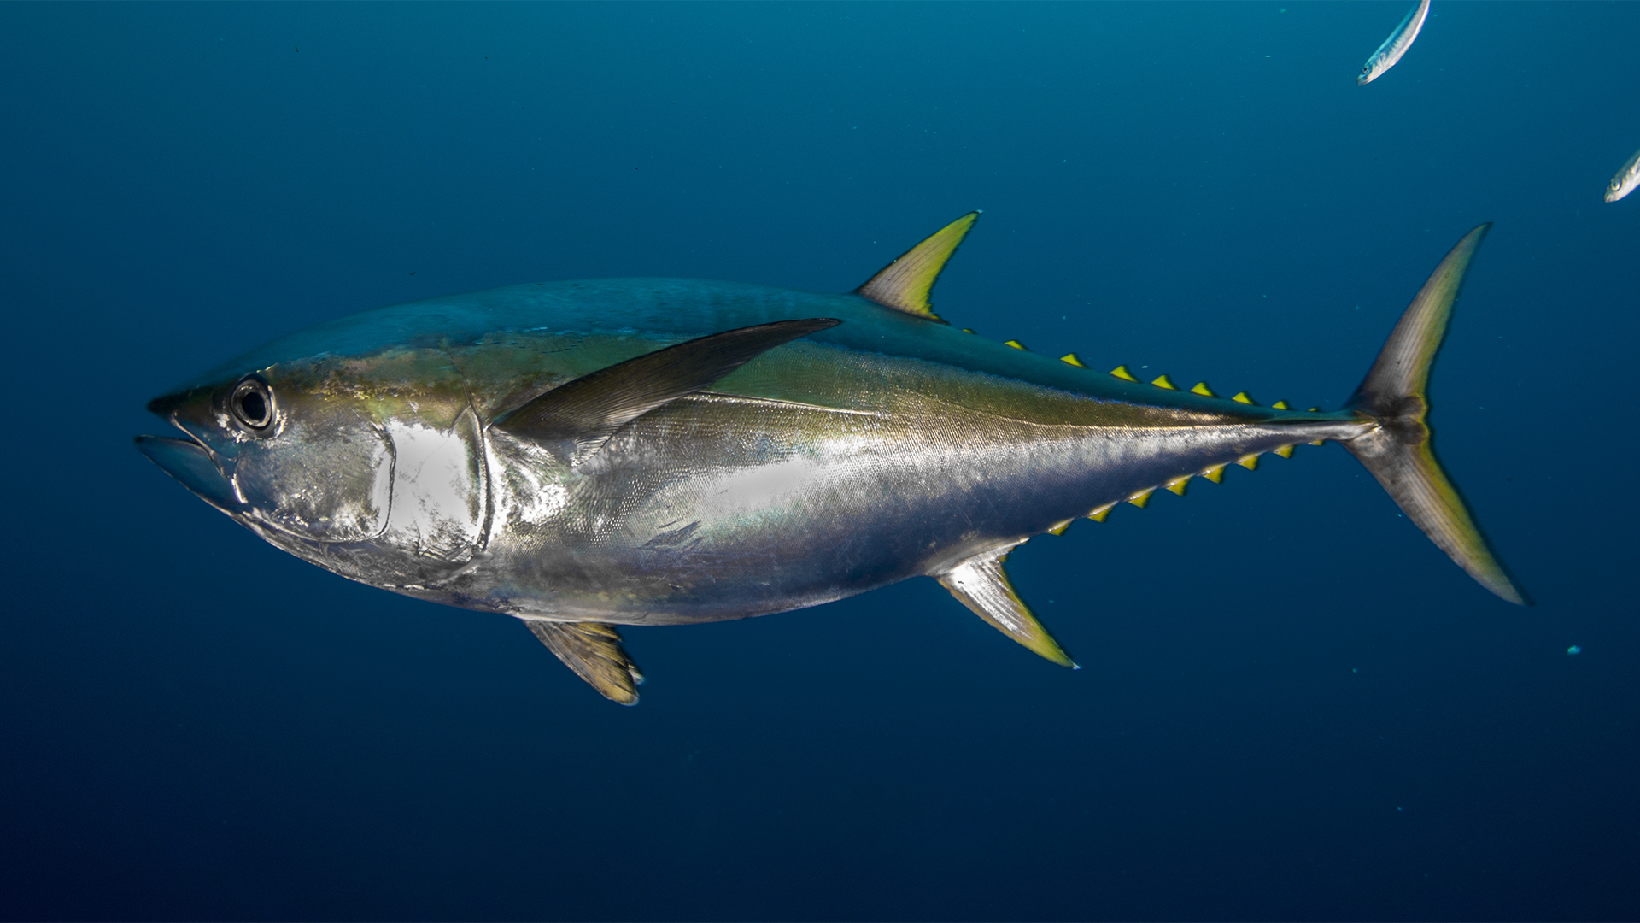
Phylum Detailed Info
Habitat-
Tropical
Temperate
Polar seas
Live almost anywhere
Reproduction-
Most reach sexual maturity at one to five year olds
Some are hermaphroditic
Feeding Strategies-
Usually filter feeders
Eats algae, seaweed, coral, cyanobacteria, copepods, crabs, shrimps, and even insect.

Slide 5
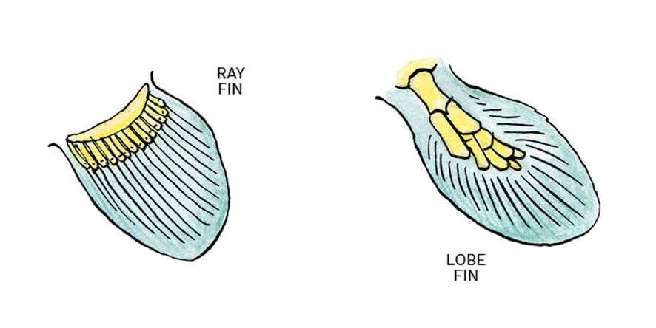
Predator/Prey-
Usually feed on prey that do not have many ways of protecting themselves
Some are also nocturnal
Smaller fishes tend to do good at hiding in coral reefs and throughout their environment.
Symmetry/Anatomy-
Bilateral symmetry
You can tell mainly by the anatomy of the pectoral fins
But lobed fish are more muscular and ray fish have thinner flexible bones
.

Slide 6
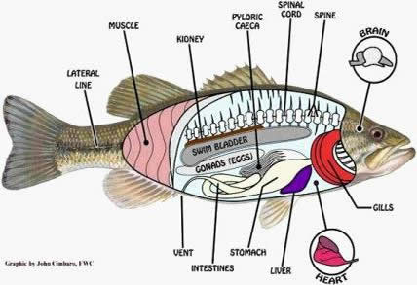

Slide 7
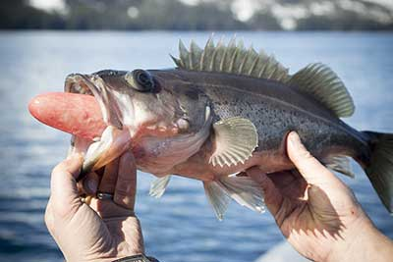
Adaptations
Adapted for better buoyancy
Swim bladder filled with gas to allowing them to stay floating
Operculum
Bone on each side of the fish that covers its gills allowing it to breathe without swimming constantly
Color Vision
The fish have a better sense of observing colorful food to eat along with spotting shelter

Slide 8
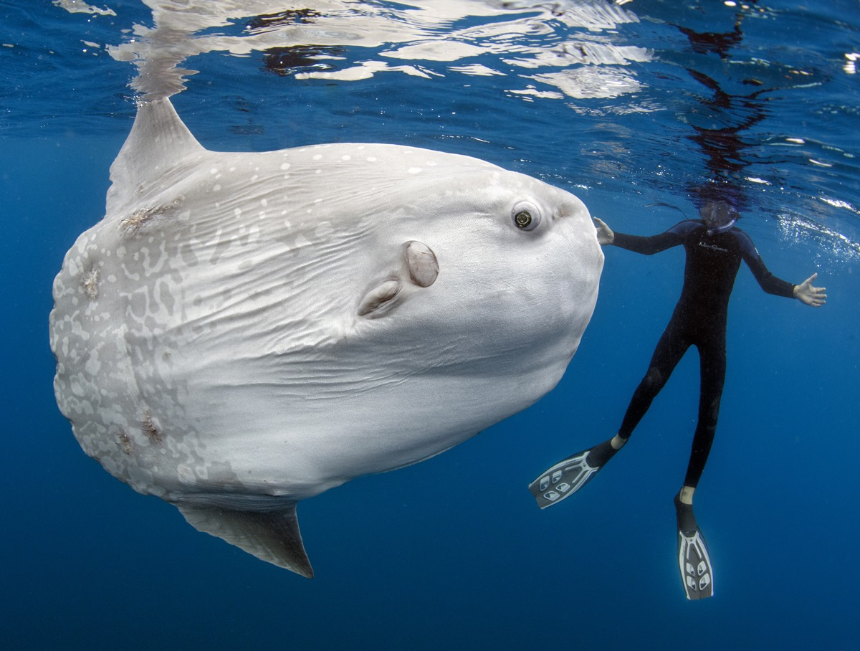
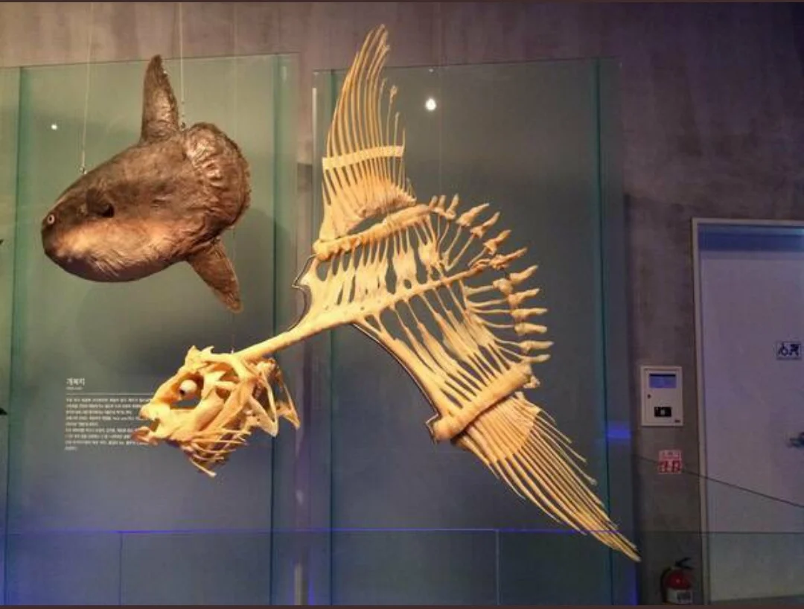
Animals
Ocean Sunfish
Largest bony fish in the world
Can reach up to 5,000 pounds
Oddly shaped fish with no tail
Eats jellyfish
Adults are too large to be threatened
California Sea lions will bite off fins and use them as frisbees

Slide 9
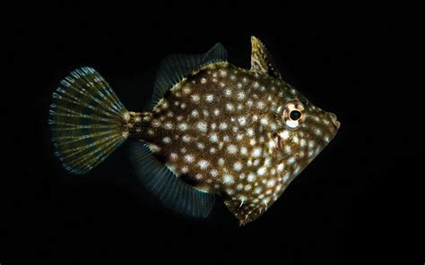
D
Pygmy Filefish
Dwarf Species ( adults usually only reaching about 3 inches)
Covered in white spots
Able to move their dorsal fins so they can hide in smaller places from predators

Slide 10
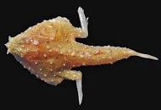
D
Pygmy Filefish
Tricorn Batfish
Brown on Dorsal Surface of head and body
Found in Florida and the Northern Gulf of Mexico to Northern South America

Slide 11
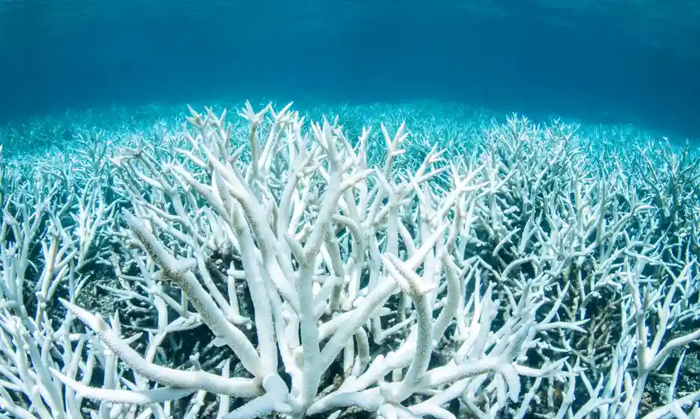
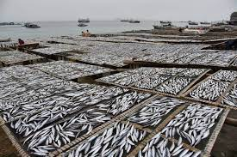
Human Impacts
Overfishing
With the variety of fish in the class a lot of them are fish we eat such as Tuna, Bass, Salmon, and Catfish
Habitat Loss
Many of these animals live in areas like coral reefs which have been destroyed because of human activity in the past 30 years

Slide 12
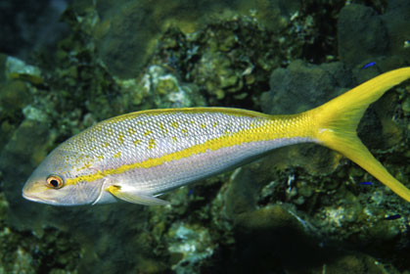
Final Analysis
The diversity in just Osteichthyes is overwhelming with over 28,000 species in this class this project could be extended and we could provide tons more information
A class can have multiple different characteristics but not every species in that class will fit into every characteristic

Slide 13
Resources
https://prezi.com/lsiq9svemf0-/osteichthyes-bony-fish/?fallback=1
https://oceana.org/marine-life/ocean-sunfish/#:~:text=The%20ocean%20sunfish%20is%20a,large%20dorsal%20and%20anal%20fins.
http://fsc.fernbank.edu/stt/vertbio/osteichthyes.htm#:~:text=Bony%20fish%20also%20have%20special,remain%20floating%20in%20the%20water.
https://www.sciencedirect.com/topics/agricultural-and-biological-sciences/osteichthyes#:~:text=The%20group%20Osteichthyes%20is%20characterised,2(d)).

Slide 14
Links
https://www.youtube.com/watch?v=MmUAg4pNB6Q (Activity)
https://www.youtube.com/watch?v=Nyu9RuJNdCo (Video clip 1)
https://www.youtube.com/watch?v=RD8XAWEmGVs (Video clip 2)
https://create.kahoot.it/details/5a76044c-e5bc-47ef-8df0-d9780d688103 (Quiz)

Slide 15
THANKS!
Does anyone have any questions?

