Slide 1
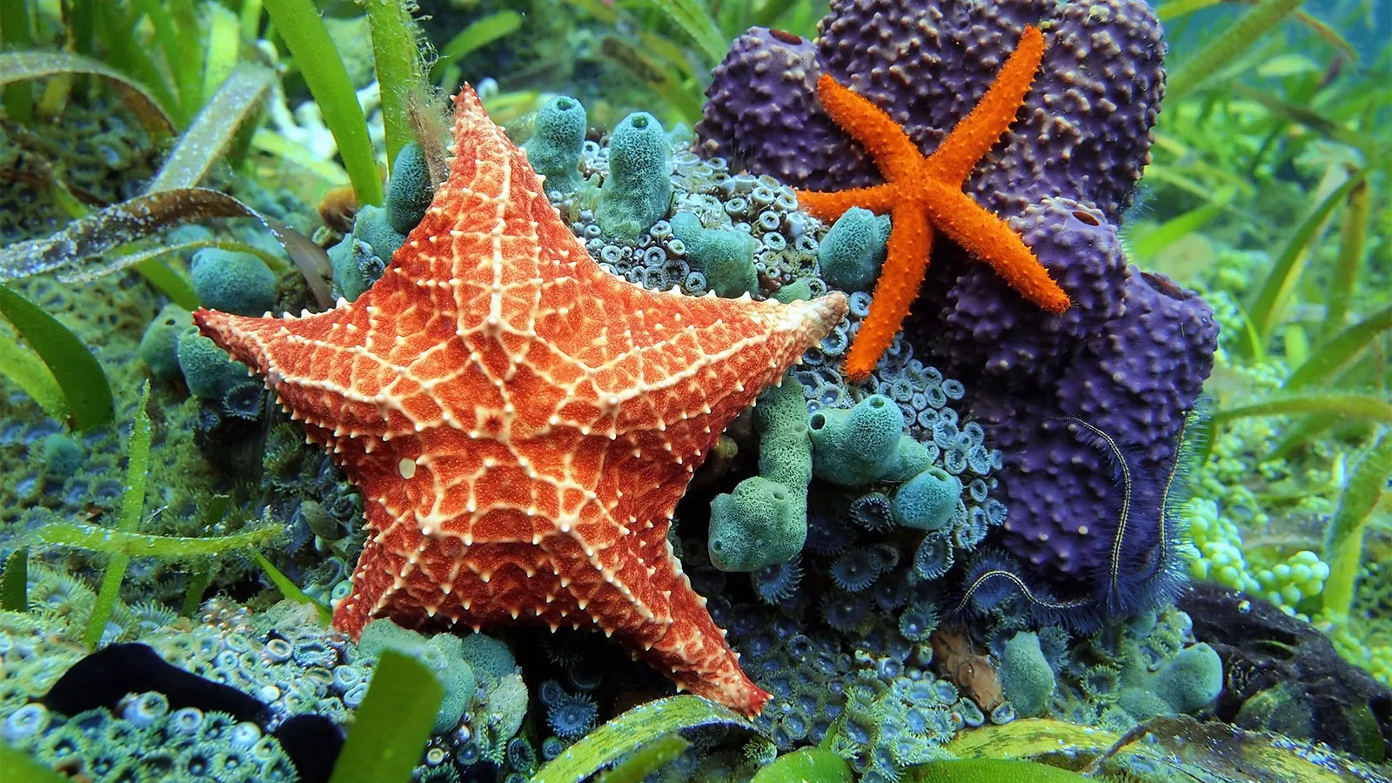
Spiny Skinned organisms
By: Laila Carlile

Slide 2
Phylum
Echinodermata
Animals include Sea Stars, Sea Urchins, Sand Dollars, and Sea Cucumbers.
7,000 species
Hard, Spiny covering of skin

Slide 3
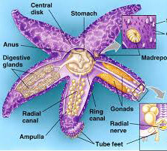
Detailed information
Predator/ Prey relationships- Prey consists of small invertebrates, sometimes other polychaete’s. Predators include Sea urchins, echinoderm, carpoid, and feature star.
Symmetry/anatomy- Radical symmetry

Slide 4
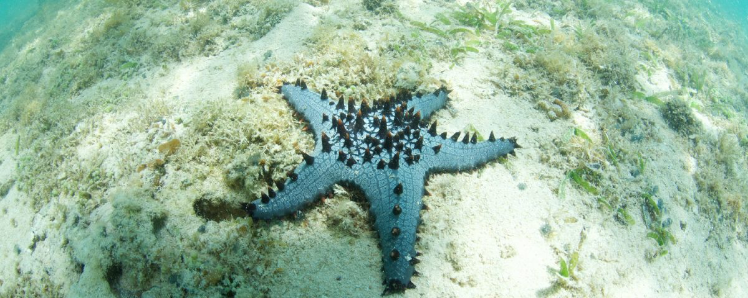
More information
Habitat- Marine waters. Almost all depths, latitudes, and environments in the ocean. They range from shallow waters to trenches.
Reproduction- the sexes are separated and the fertilization is external.
Feeding strategies- Obtain food by capturing or filtering suspended particles from the water columns.

Slide 5
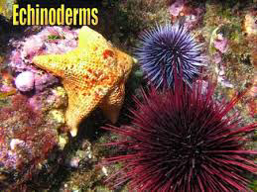
3 Adaptations
The ability to regenerate amputated limbs and lost body parts.
Developing various specialized feeding habits.
Have developed special digestive systems adapted to the food sources found in their particular environment.

Slide 6
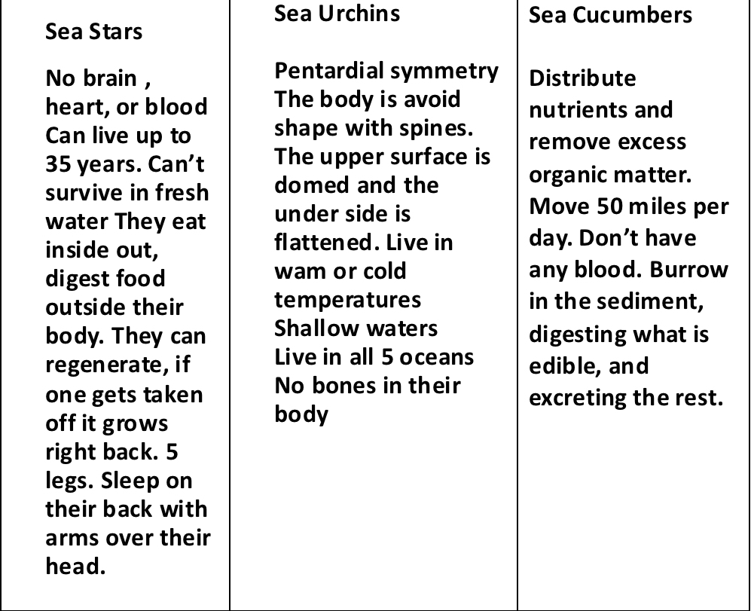
3 animals of this phylum

Slide 7
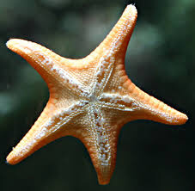
Human Impacts
Negative- Habitat destruction
Positive- Provide important clues for human medicine that more distantly related regenerating animals can’t.
These organisms are used as a biological resource for humans by- they have been used as model organisms in studies of a wide variety of other types of disease processes

Slide 8
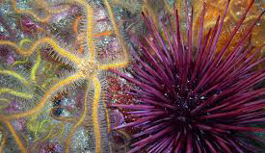
The end
Spiny- skinned organisms are a very interesting species to learn about.
It is very cool how they have no bones, blood, or even a heart.
I think Spiny- Skinned organisms are very cool
https://www.youtube.com/watch?v=IOgbx6gA8Sw

Slide 9
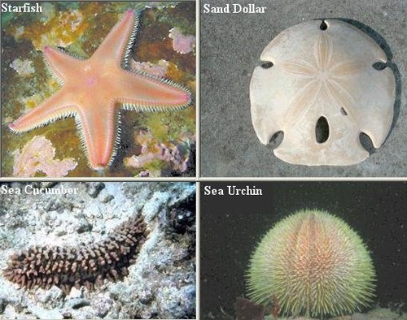
My 5 question quiz
1. What type of organisms are Sea Urchins, Sand Dollars, Sea Cucumbers? Spiny Skinned
2. Are Spiny Skinned animals vertebrates or invertebrates? No
3. What habitat do these organisms live in? Marine waters
4. What phylum do they live in? Echinodermata
5. True or False: All 3 of these organisms have blood. False

