Slide 1
TTQ- Mitosis
Name:
Per:
Match the phase to what is happening in the cell:
Interphase | Prophase | Metaphase | Anaphase | Telophase
Chromosomes line up at the equator of the cell______________________________________________________
Nuclear envelope is completely dissolved and DNA has coiled into visible chromosomes_____________________
Two new nuclei are re-formed around uncoiling chromosomes__________________________________________
Chromosomes move to opposite poles of the cell_____________________________________________________
The cell prepares to divide by becoming larger and duplicating its DNA__________________________________
Complete the table by checking the correct column for each statement.
Identify the following phases of mitosis use these terms: telophase, metaphase, anaphase, prophase
Then Label the diagram: use these terms: sister chromatids, centromere, spindle fibers, centrioles.

Slide 2
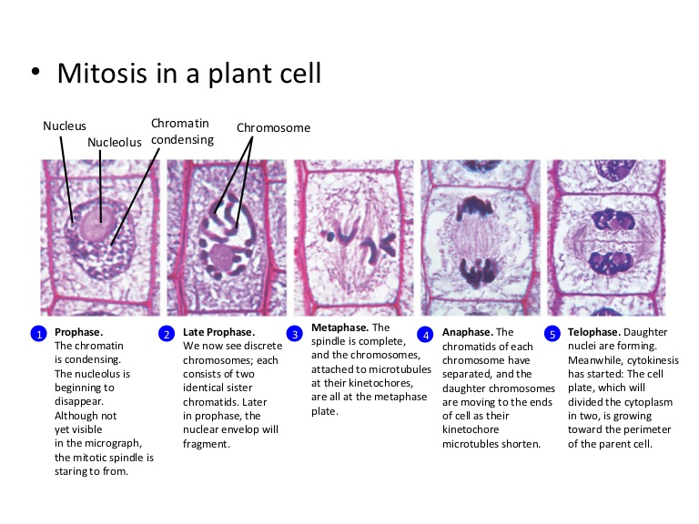
The following are not in the correct order. Please answer the questions below.
1. Which cell is in metaphase? ______________________________________________________________
2. Cells A and F show an early and late stage of the same phase of mitosis. What phase is it? ____________
3. In cell A, what is the function of the structure labeled X? ________________________________________
4. Which cell is not in a phase of mitosis? ______________________________________________________
5. What are the two main changes that are taking place in cell B? __________________________________
_______________________________________________________________________________________
6. Sequence the six diagrams in order from first to last.
1.______ 2._______ 3._______ 4._______ 5._______ 6._______
7. What is the end product of mitosis? ________________________________________________________
8. Describe the process of cytokinesis in animal cells. ____________________________________________ ________________________________________________________________________________________
Identify the following phases of mitosis
9.
10.
11.
12.

